Slide 1


Listening through a Vibration Motor
Romit Roy Choudhury
Nirupam Roy

Slide 2

Vibration motor
Notes:
Every smartphone has a tiny device called vibration motor that generates the vibration alert.

Slide 3
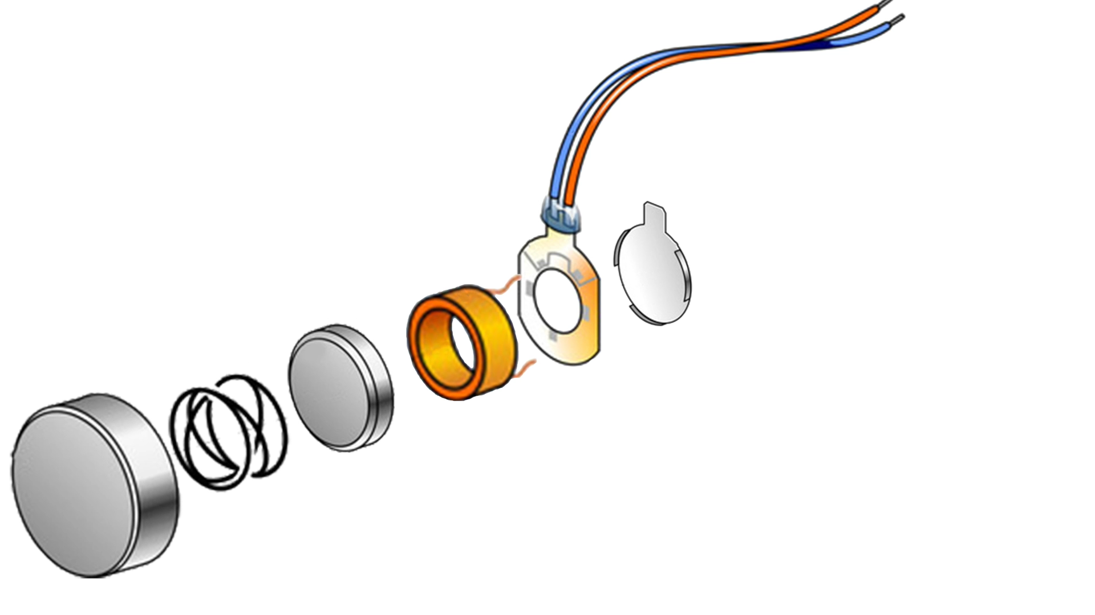


Driving voltage
Coil
Magnetic mass
Notes:
Inside the motor, the controller applies voltage to the coil that creates a magnetic field.

Slide 4
Driving voltage
Coil
Magnetic mass
Notes:
This oscillating magnetic field makes the magnetic mass to move. This movement creates the vibration.

Slide 5
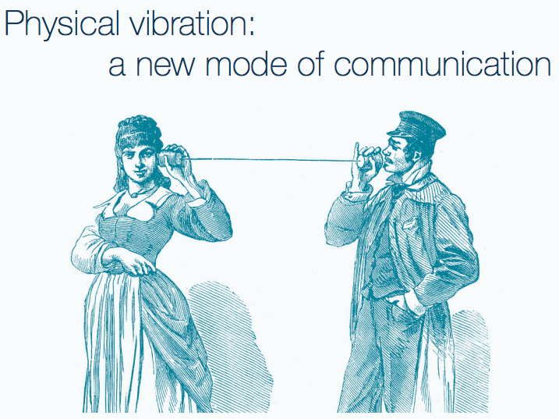
Project Ripple: Communicating through
Physical Vibrations

Slide 6
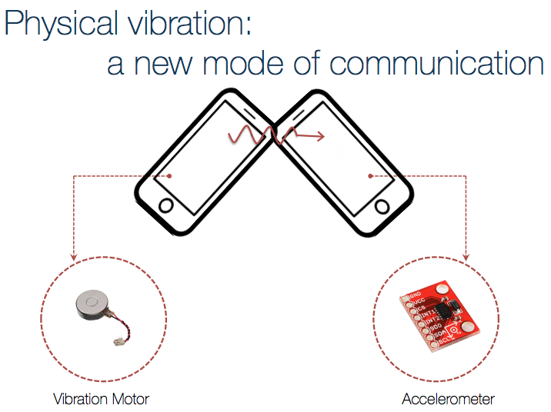
Project Ripple: Communicating through
Physical Vibrations
Vibra Motor
Accelerometer,
Microphone

Slide 7
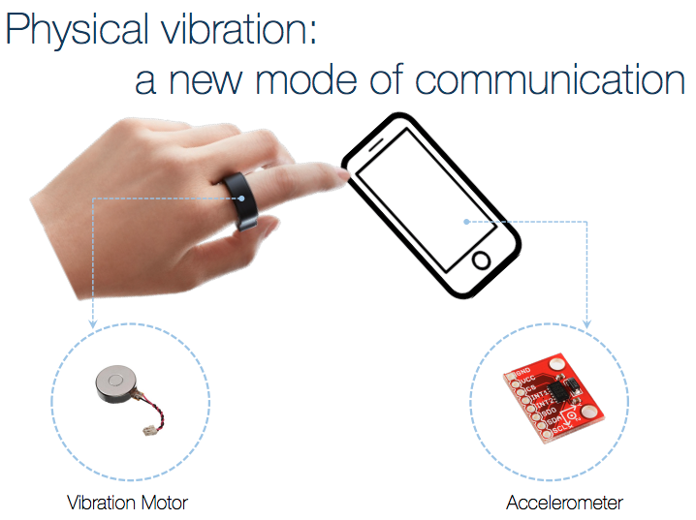
Project Ripple: Communicating through
Physical Vibrations
Vibra Motor
Accelerometer,
Microphone

Slide 8

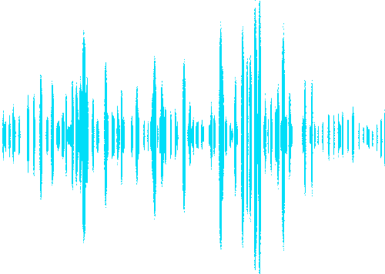
External sound
Reverse voltage (Back-EMF)
Notes:
We have observed that external sound can also create subtle movement in the mass. This generates a reverse voltage in the coil.

Slide 9
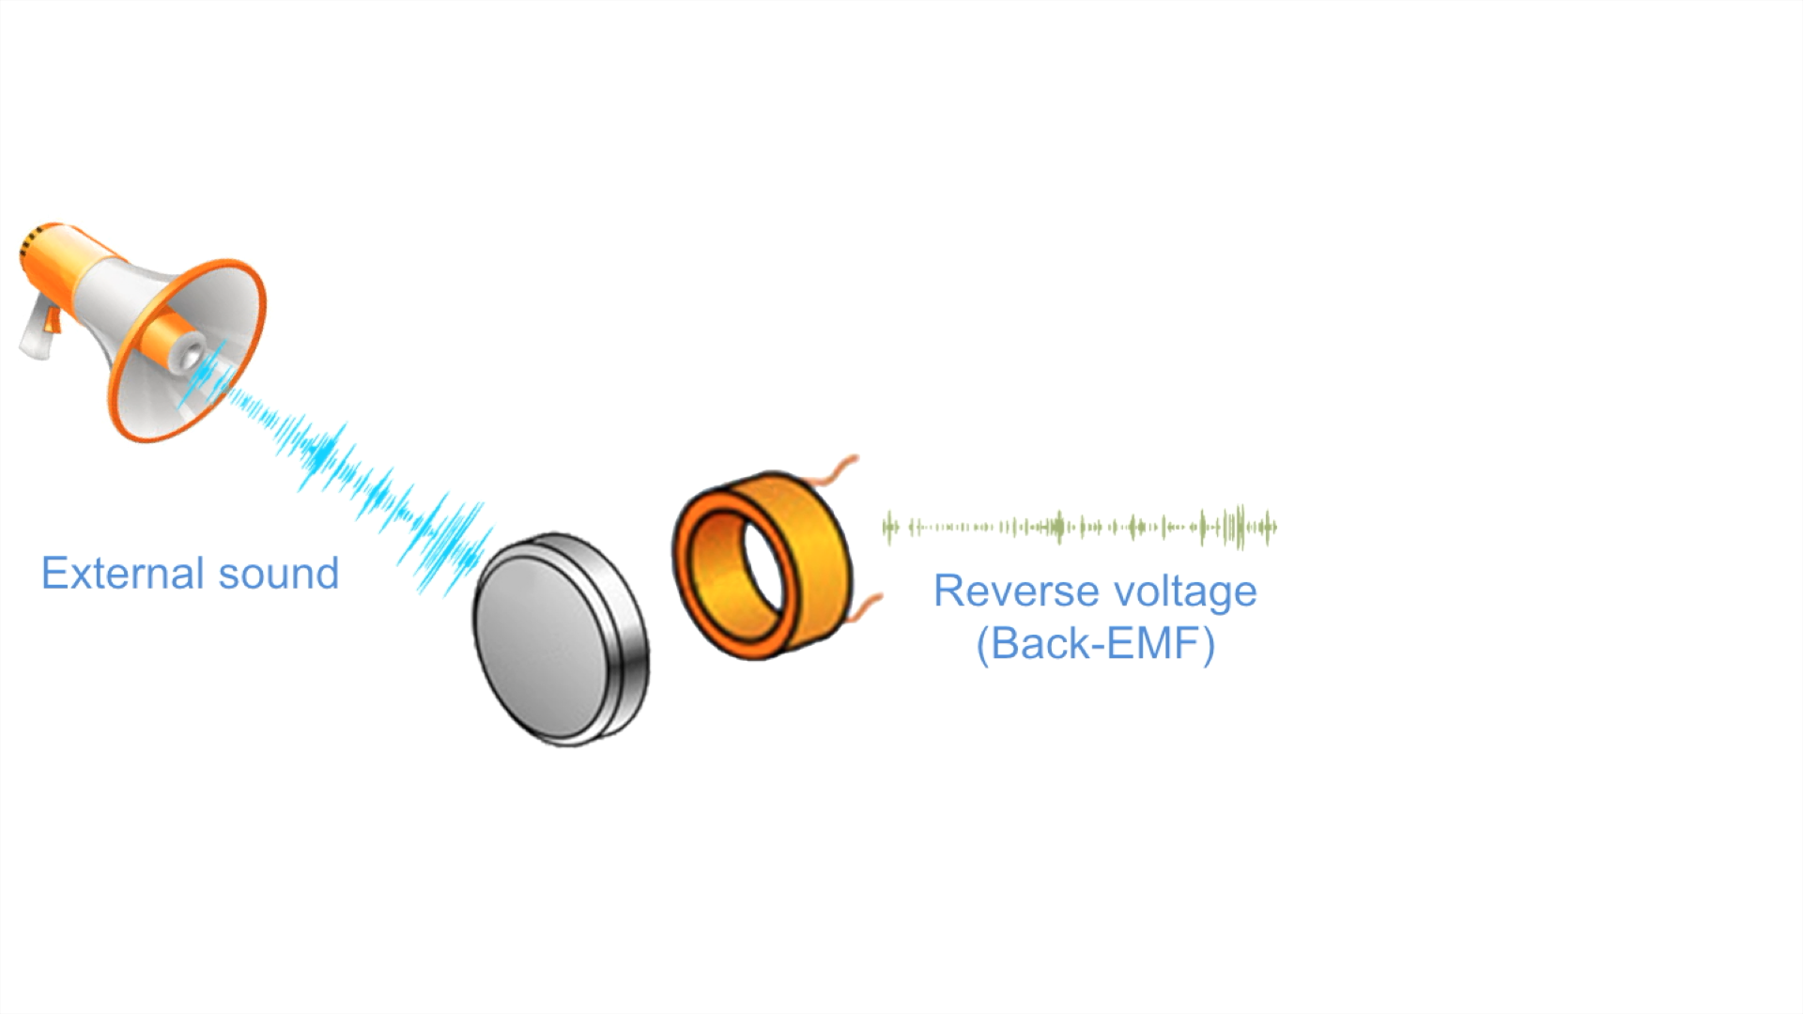
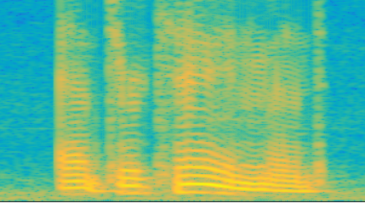
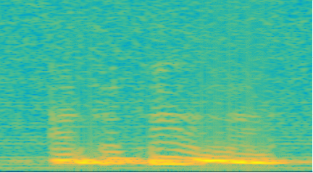
Sound spectrum
Back-EMF spectrum
External sound
Reverse voltage (Back-EMF)
We ask:
Can we recover speech from vibration motor?
Notes:
This reverse voltage or the BackEMF is proportional to the movement of the mass i.e. the sound wave. We can extract this voltage to recover the sound from the vibration motor.

Slide 10

Is this a threat?
Side channel attack
leaking voice data
Notes:
This reveals a side channel attack where the the smartphones can bypass the microphone to record the users phone call.

Slide 11
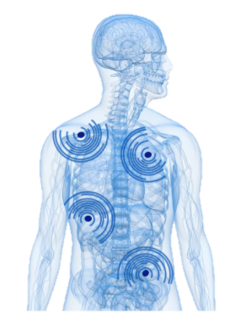


Is this a threat?
Side channel attack
leaking voice data
This paper focuses only on understanding the capability,
and generating awareness … apps may emerge in time
Or Opportunity?
Both:
Voice commands
Haptic feedback
Microphone + vibra-motor = MIMO for speech
Notes:
This reveals a side channel attack where the the smartphones can bypass the microphone to record the users phone call.

Slide 12
Understanding Human Speech Production

Slide 13
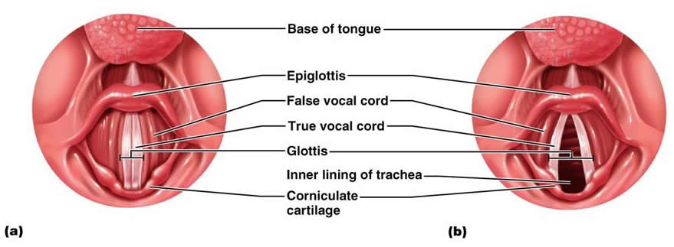
2 Foundation Sounds
Voiced
Unvoiced

Slide 14
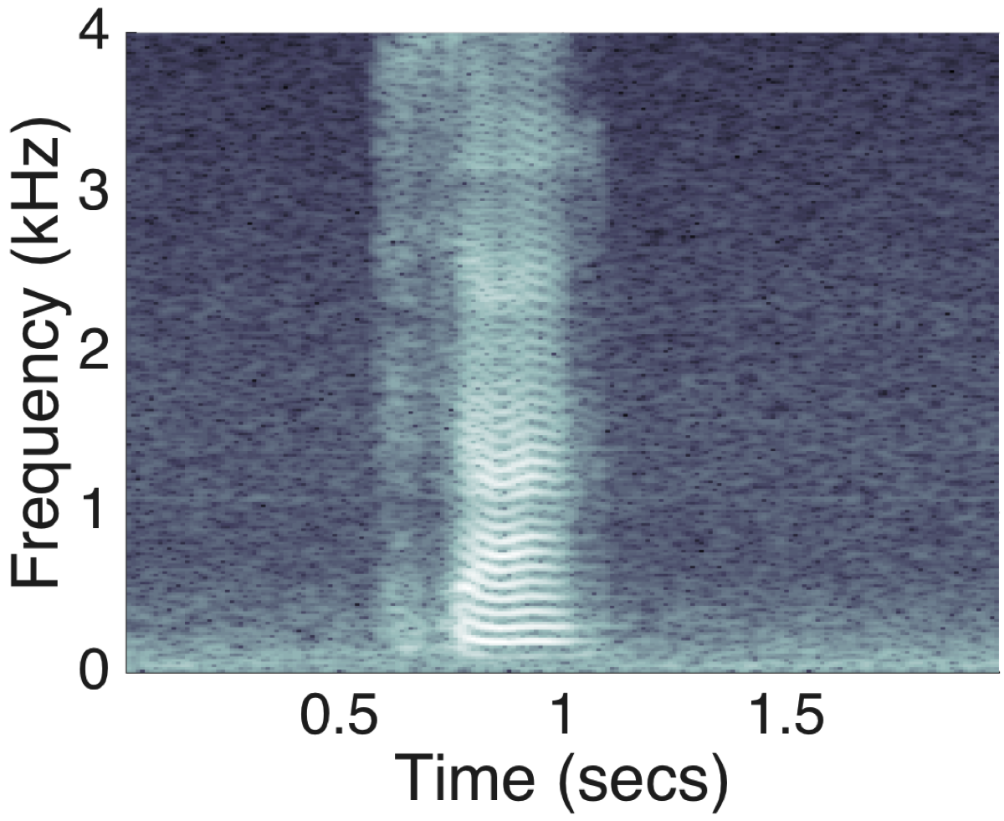
2 Foundation Sounds
Voiced
Unvoiced
Voiced signals like harmonics. Examples
(vowels, b, g)
Unvoiced signals are like noise. Examples
(s, f, k, t)

Slide 15
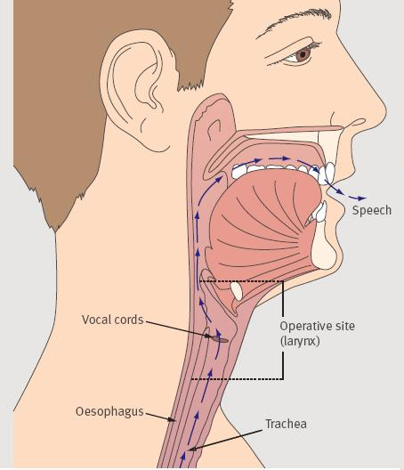
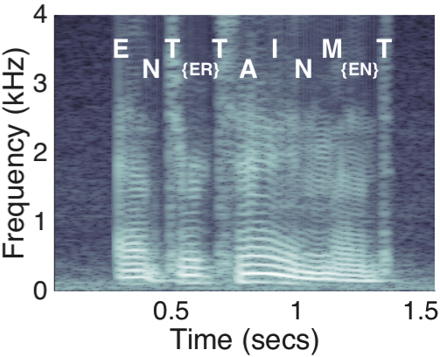
Vocal Track Further Modulates Signal

Slide 16
Modeled as a Source-Filter System

Slide 17
When Recorded with Vibra-motors …
Vibration
Motor

Slide 18
When Recorded with Vibra-motors …
Vibration motor
response
Goal: Can we undo the vibra-motor response

Slide 19
3 Key Challenges …

Slide 20
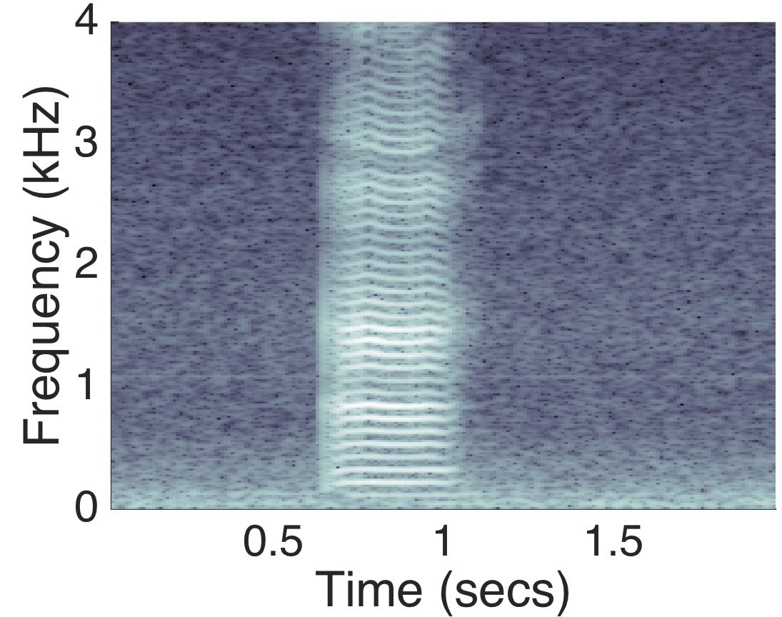
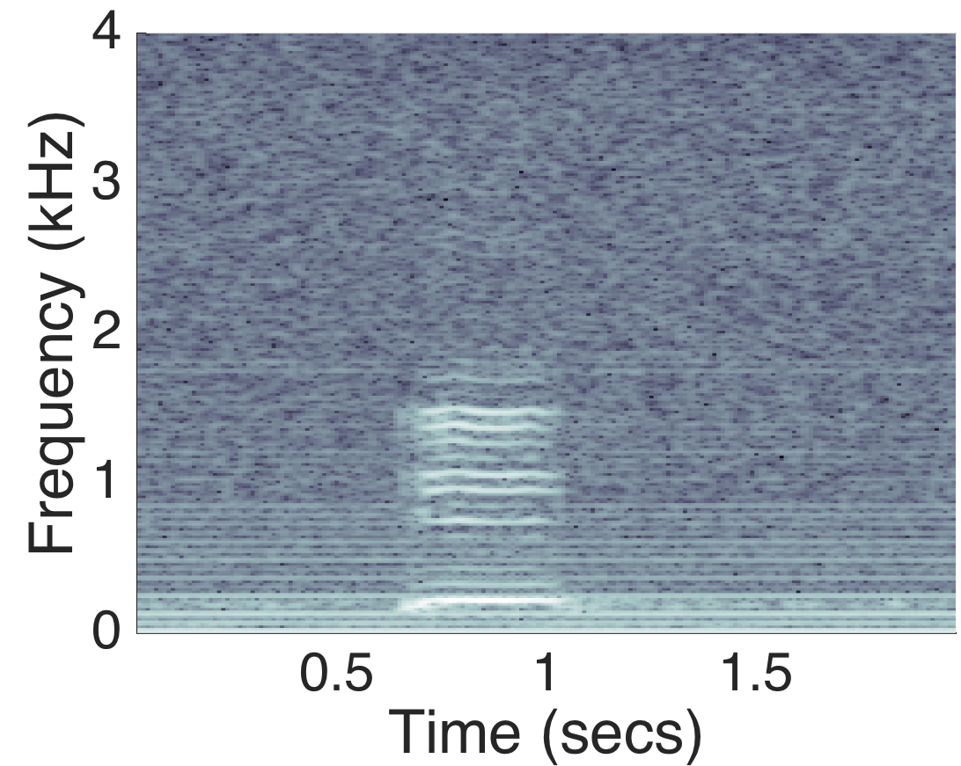
3 Key Challenges
High Frequency Deafness
Microphone (vowel ‘a’)
Vibra-motor (vowel ‘a’)

Slide 21
3 Key Challenges
High Frequency Deafness
Over-Sensitivity at Resonance Frequency
Microphone (sine sweep)
Vibra-motor (sine sweep)
Resonance freq.

Slide 22
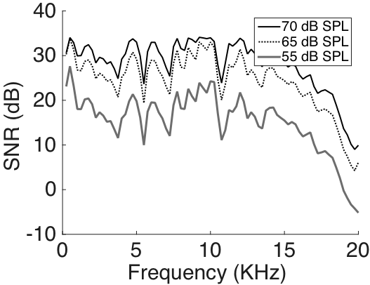
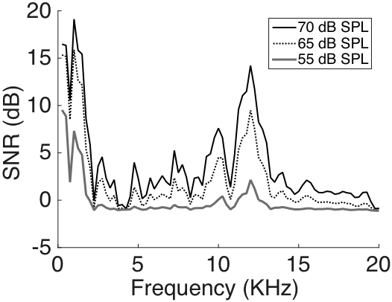
3 Key Challenges
High Frequency Deafness
Over-Sensitivity at Resonance Frequency
Higher Energy Threshold → Low SNR
Microphone SNR
Vibra-motor SNR

Slide 23
VibraPhone: System Overview

Slide 24
Speech recovery
Pre-processing
Speech synthesis

Slide 25
Speech recovery
Pre-processing
Speech synthesis
Frequency equalization
Background noise removal
Speech energy localization

Slide 26
Speech recovery
Pre-processing
Speech synthesis
Frequency equalization
Voice source expansion
Background noise removal
Speech reconstruction
Speech energy localization

Slide 27
Speech recovery
Pre-processing
Speech synthesis
Frequency equalization
Voice source expansion
Background noise removal
Speech reconstruction
Speech energy localization

Slide 28
Speech recovery
Pre-processing
Speech synthesis
Frequency equalization
Voice source expansion
Background noise removal
Speech reconstruction
Speech energy localization

Slide 29
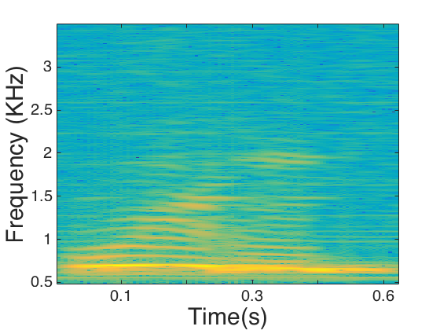
Identifying Hidden Energy in Speech
Signals present in
the higher frequencies,
but buried under noise.
Notes:
The energy of the vibration motor signal…

Slide 30
Identifying Hidden Energy in Speech
Run cross-correlation to
identify spikes, an indication
of presence of speech signal
Notes:
The energy of the vibration motor signal…

Slide 31
Identifying Hidden Energy in Speech
Run cross-correlation to
identify spikes, an indication
of presence of speech signal
Notes:
The energy of the vibration motor signal…

Slide 32
Identifying Hidden Energy in Speech
Subtract noise signals copied
from around the speech
windows: spectral subtraction
Notes:
The energy of the vibration motor signal…

Slide 33
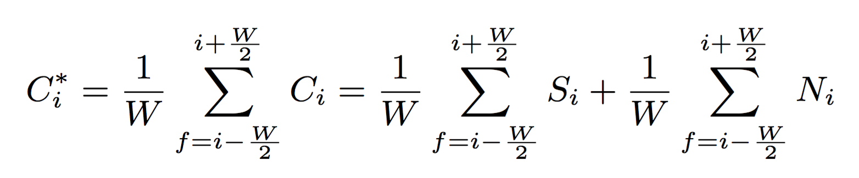
Identifying Hidden Energy in Speech
Further average over frequency
windows to improve SNR (zero
Mean Gaussian noise is reduced)
Notes:
The energy of the vibration motor signal…

Slide 34
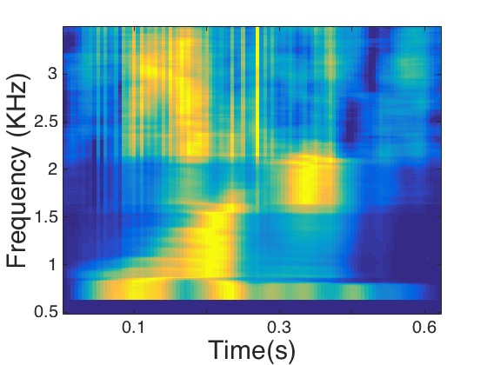
Identifying Hidden Energy in Speech
Notes:
The energy of the vibration motor signal…

Slide 35
Identifying Hidden Energy in Speech
Now, pick areas of dominant signals (via clustering) and
zero force the remaining signals → a mask
Notes:
The energy of the vibration motor signal…

Slide 36
Identifying Hidden Energy in Speech
Now, pick areas of dominant signals (via clustering) and
zero force the remaining signals → a mask
Of course, harmonic structure lost, but we know where signal is strong
Notes:
The energy of the vibration motor signal…

Slide 37
Speech recovery
Pre-processing
Speech synthesis
Frequency equalization
Voice source expansion
Background noise removal
Speech reconstruction
Speech energy localization

Slide 38
Human Speech Production
Foundation sounds
Source-filter model of speech system
Notes:
We need the foundation sound to apply the energy mask on.

Slide 39
Voice Source Expansion
Notes:
To generate the foundation sounds at the high frequency we replicate the fundamental frequency at the location of its harmonics. For the unvoiced part we just copy the random noise at the high frequencies.

Slide 40
Voice Source Expansion
Harmonics aware replication of lower frequencies
Notes:
To generate the foundation sounds at the high frequency we replicate the fundamental frequency at the location of its harmonics. For the unvoiced part we just copy the random noise at the high frequencies.

Slide 41
Speech Reconstruction
Exponential Decay
+
Weighted Sum
Notes:
Now we apply the speech-energy structure over the foundation sounds as a weighted mask. After then we apply a exponential decay that emulates the human voice which has exponentially low gains at the high frequencies.

Slide 42
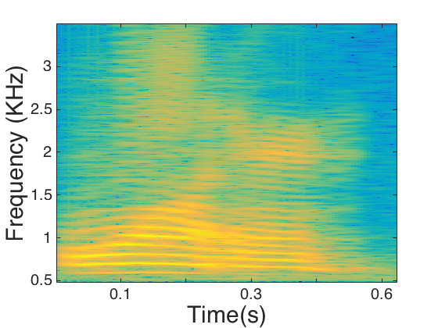
Speech Reconstruction
Exponential Decay
+
Weighted Sum
Notes:
Now we apply the speech-energy structure over the foundation sounds as a weighted mask. After then we apply a exponential decay that emulates the human voice which has exponentially low gains at the high frequencies.

Slide 43
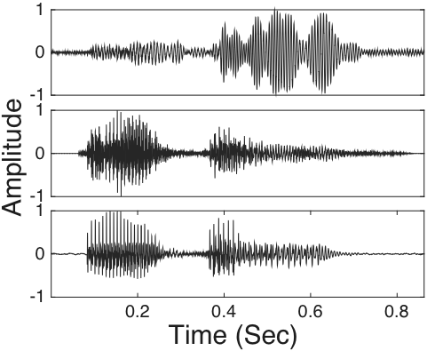
Time Domain Reconstruction for Word “often”
Raw vibration
VibraPhone
Microphone

Slide 44

Audio Demo
Original song
Raw motor signal
VibraPhone
Notes:
The song: “Mary had a little lamb”

Slide 45
Evaluation

Slide 46
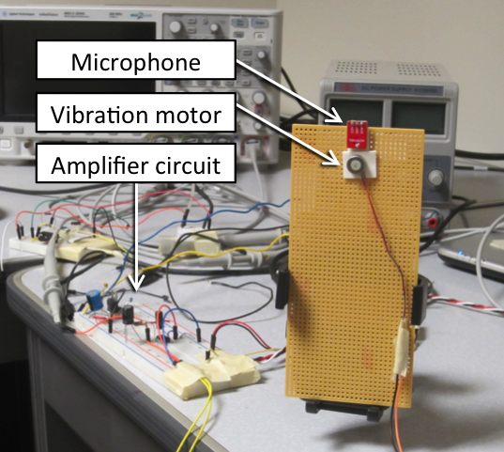
Evaluation Platforms
Custom Hardware
Smartphone Set up

Slide 47


Evaluation Method
Sources
Speaker
Human

Slide 48
Evaluation Method
Recording platforms
Sources
Speaker
Custom setup
Human
Smartphone setup

Slide 49


Evaluation Method
Recording platforms
Decoding methods
Sources
Automatic speech recognition
Speaker
Custom setup
Human
Manual speech recognition
Smartphone setup

Slide 50
Results: Automatic Speech Recognition

Slide 51
Results: Manual Speech Recognition

Slide 52


Results: Automatic Speech Recognition
Top 10 correctly decoded word
Top 10 incorrectly decoded word

Slide 53
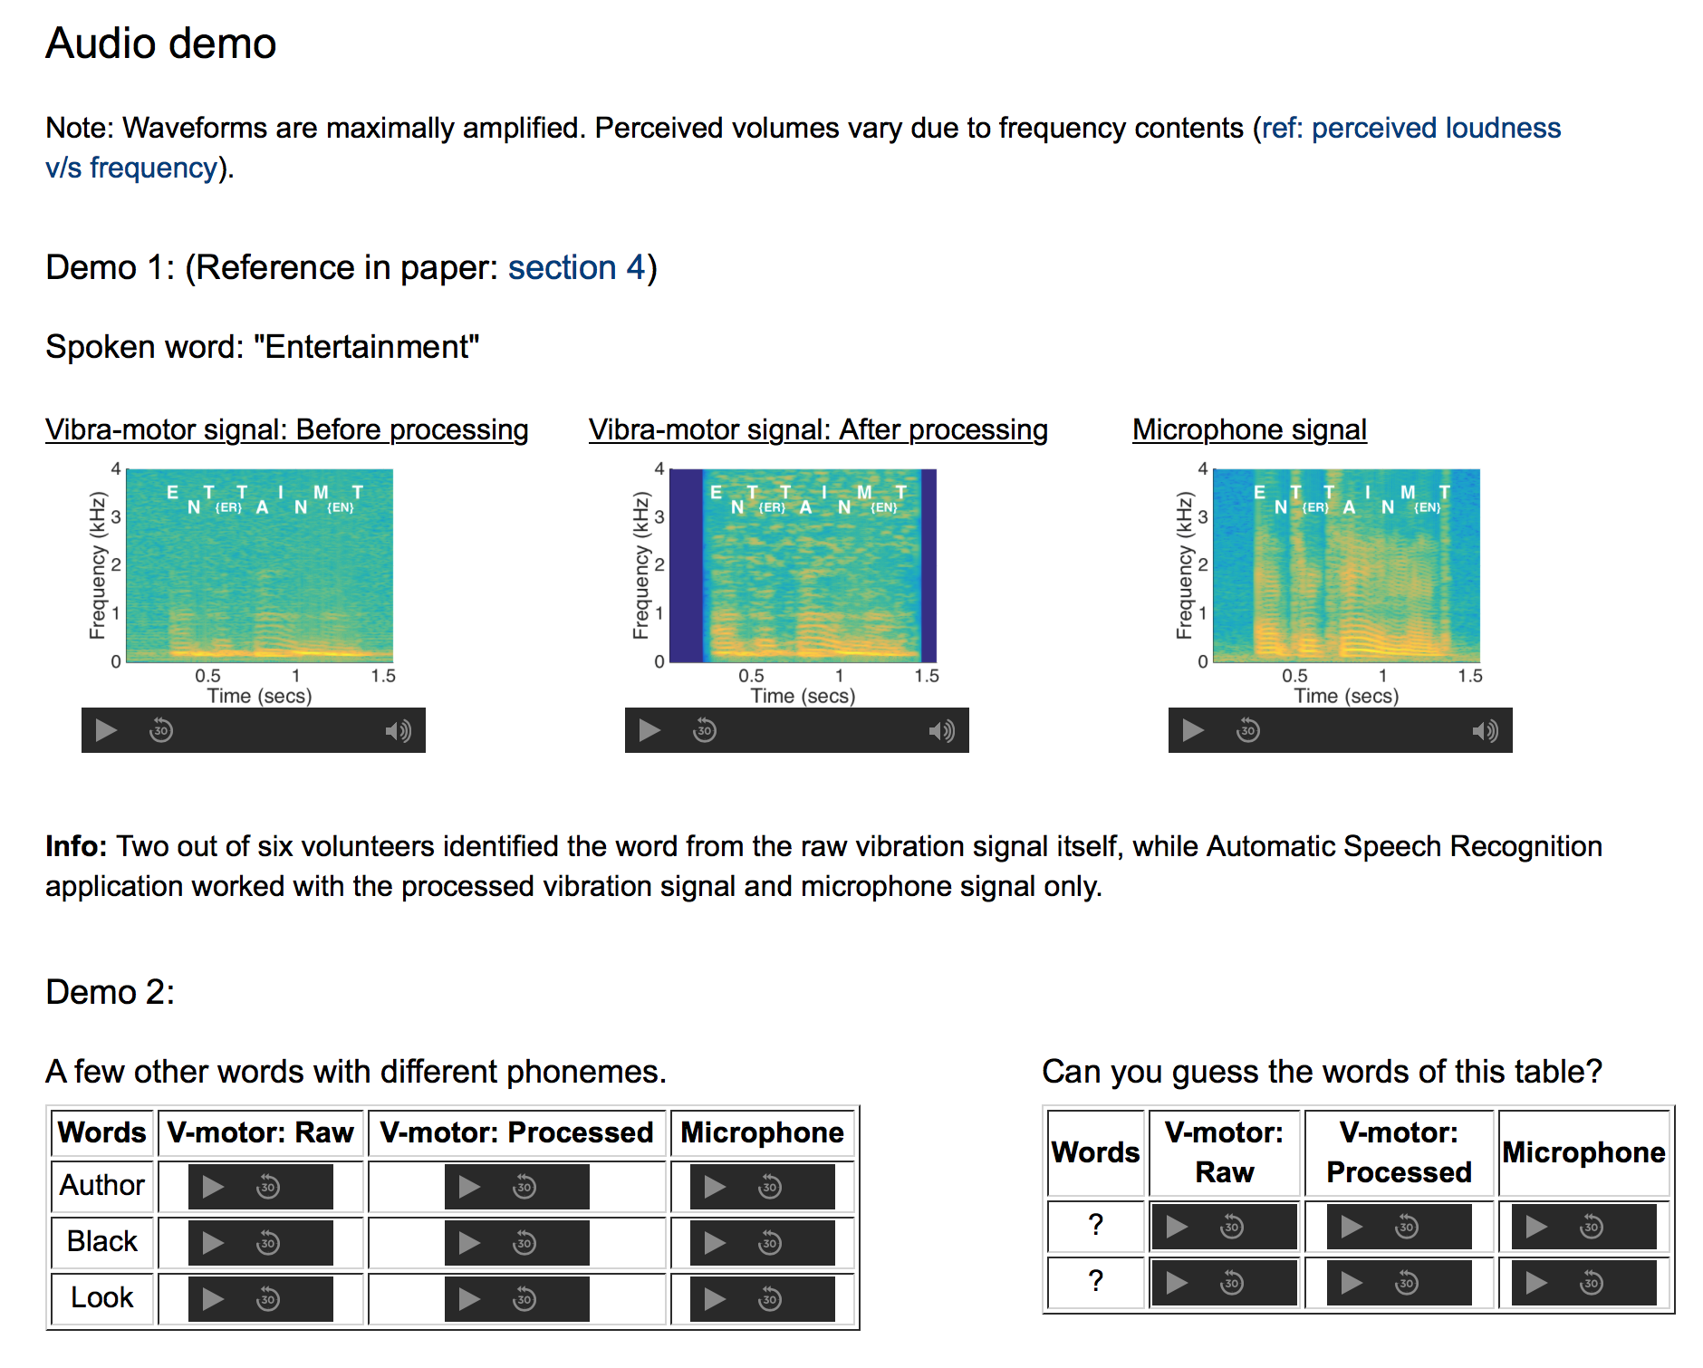
More audio demos available here:
http://synrg.csl.illinois.edu/vibraphone

Slide 54
Points of Discussion
VibraPhone cannot launch on your phone/watch now
We lack a notion of optimality here
We have sidestepped the energy question
Applications?

Slide 55
Related Work
Several closely related work on sensory side channels
Gyrophone [Stanford]
AccelWord [UC Davis]
Motion Microscope [MIT]
The core difference:
We are not a ML/classification based approach
Attempting to decode speech (any spoken word)
GyroPhone, AccelWord “train” on specific keywords
Motion microscope does not train, but it’s a visual approach

Slide 56
Concluding Message
Possible to decode speech by decoding the
response of the vibration motor.
This is not fundamentally surprising …
But the ease of “decoding” signals was unexpected.
Importantly, the decoded sounds are not just patterns that
matches english “words” … rather, they contain actual human speech constructs … decodable by speech recognizers
Notes:
We have observed that external sound can also create subtle movement in the mass. This generates a reverse voltage in the coil.

Slide 57
Thank You
Visit our website: http://synrg.csl.illinois.edu/
Notes:
Thank you.

