Slide 1
Practical Indoor Localization With Zero Start-up Cost
Kun Qian

Slide 2
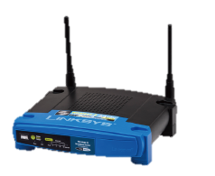

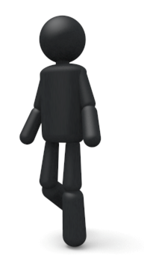
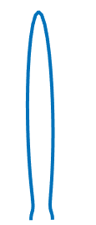
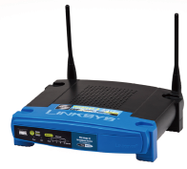


AoA enhances localization …
Common Localization Scheme via AoA.
ArrayTrack, NSDI ’13

Slide 3
However, when deploying schemes like ArrayTrack …
1. Requiring dedicated APs with 6~8 antennas.
2. Requiring deployment
for each WLAN
3. Requiring calibration after each startup.

Slide 4
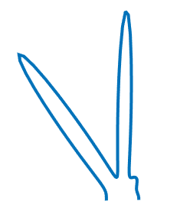
Until Dina saves us …
Localization at client side.
1. Requiring only one antenna at each anchor.
2. Requiring only location information of anchors.
3. Free from calibration.
Ubicarse, Mobicom ’14

Slide 5
However, Ubicarse is not perfect …
Ubicarse cannot be directly extended to more that 2 antennas.
Rest antennas cannot be efficiently leveraged by Ubicarse (Say, the 3rd antenna on 5300).
Ubicarse requires the rotation to be performed around the vertical axis of the mobile device.
Humans cannot perform such perfect rotation.
Ubicarse fails to explicitly tell the difference between two types localization schemes.

Slide 6
Then, our contribution is possibly …
Extend the scheme to arbitrary antenna array (#antenna, shape, etc).
Extend the scheme to enable arbitrary rotation.
Specify the general localization method for localization at mobile client side.

Slide 7



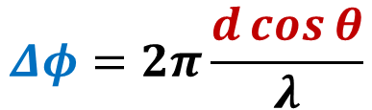


2-D AoA
$$φ_{2}$$
Source
$$Δφ$$
$$d\cos{θ}$$
$$θ$$
$$φ_{1}$$
1
d
2
Two-Antenna Array
Signal Phase
$$Δφ=2π\frac{d\cos{θ}}{λ}$$

Slide 8



3-D AoA
$$τ$$
$$γ$$
$$θ$$
𝐜𝐨𝐬⁡𝜽=𝐜𝐨𝐬⁡𝜸𝐜𝐨𝐬⁡𝝉
Todo:
Figure out if the AoA model is correct…
- Signal AoA & Antenna Polorization.
Find efficient AoA estimation algorithm.

Slide 9
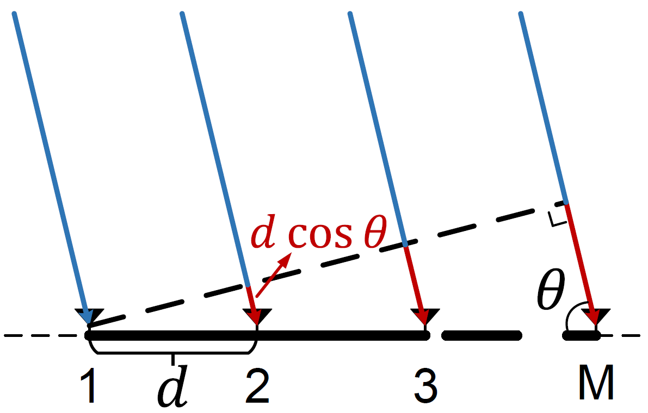
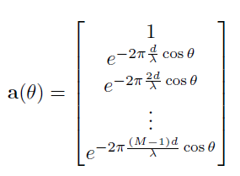
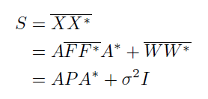
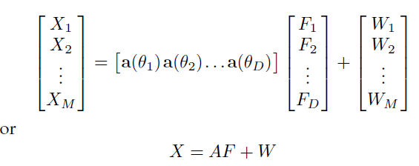

MUSIC
Steer
vector
Correlation
Matrix
Signals.
Pseudo
Spectrum

Slide 10
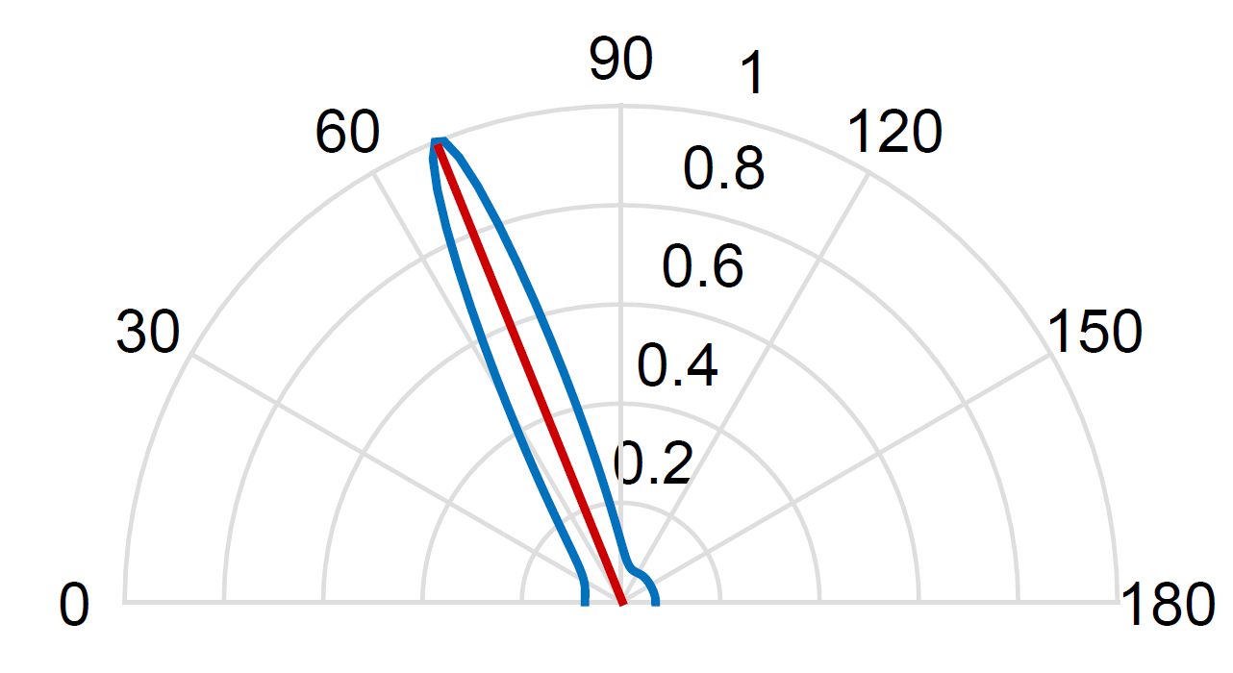
Pseudo Spectrum

Slide 11
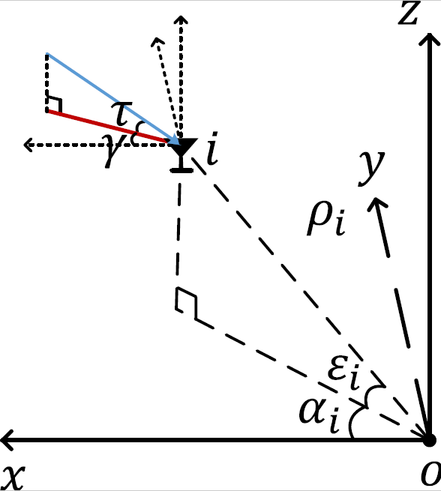

C1: Arbitrary Antenna Array.
The element phase for the i-th antenna is:

Slide 12
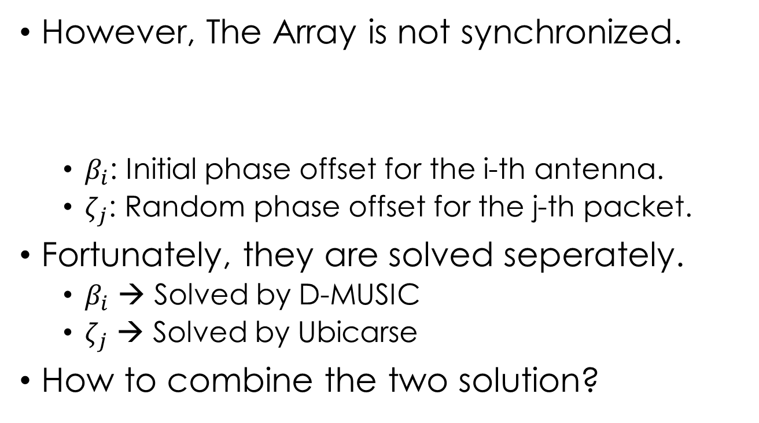
C1: Arbitrary Antenna Array.
However, The Array is not synchronized.
$β_{i}$: Initial phase offset for the i-th antenna.
$ζ_{j}$: Random phase offset for the j-th packet.
Fortunately, they are solved seperately.
$β_{i}$ → Solved by D-MUSIC
$ζ_{j}$ → Solved by Ubicarse
How to combine the two solution?

Slide 13
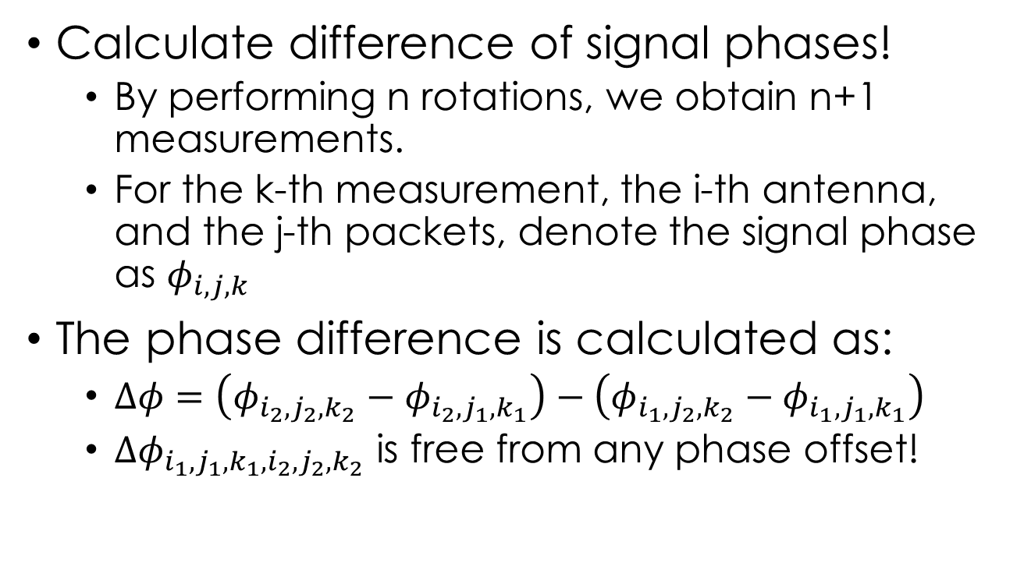
C1: Arbitrary Antenna Array.
Calculate difference of signal phases!
By performing n rotations, we obtain n+1 measurements.
For the k-th measurement, the i-th antenna, and the j-th packets, denote the signal phase as $φ_{i,j,k}$
The phase difference is calculated as:
$Δφ=\left(φ_{i_{2},j_{2},k_{2}}−φ_{i_{2},j_{1},k_{1}}\right)−\left(φ_{i_{1},j_{2},k_{2}}−φ_{i_{1},j_{1},k_{1}}\right)$
${Δφ}_{i_{1},j_{1},k_{1},i_{2},j_{2},k_{2}}$ is free from any phase offset!

Slide 14
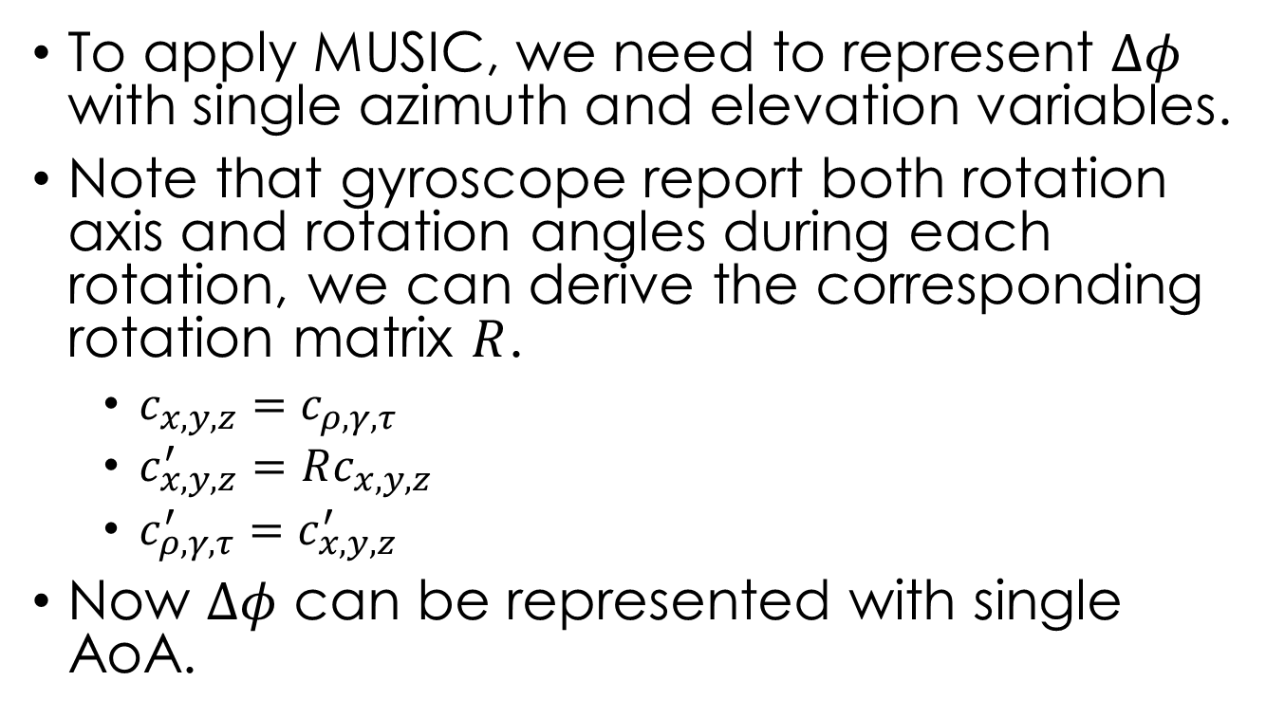
C2: Arbitrary Rotation.
To apply MUSIC, we need to represent $Δφ$ with single azimuth and elevation variables.
Note that gyroscope report both rotation axis and rotation angles during each rotation, we can derive the corresponding rotation matrix $R$.
$c_{x,y,z}=c_{ρ,γ,τ}$
$c_{x,y,z}^{′}=$ $Rc_{x,y,z}$
$c_{ρ,γ,τ}^{′}=c_{x,y,z}^{′}$
Now $Δφ$ can be represented with single AoA.

Slide 15
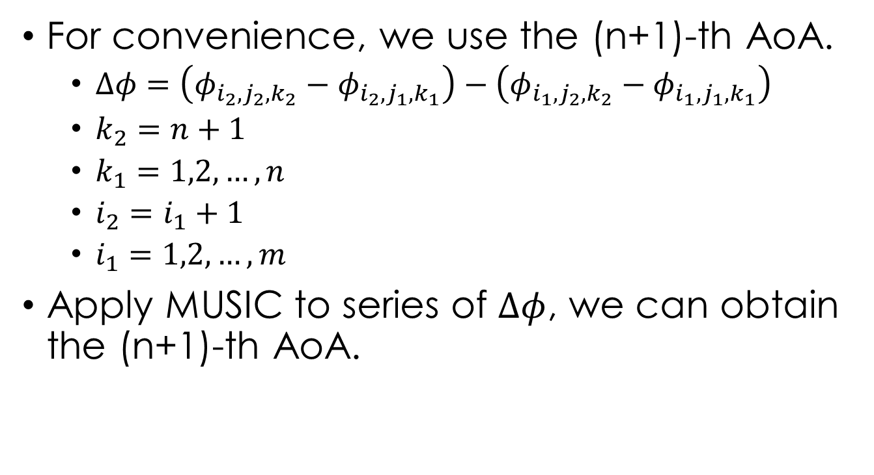
C2: Arbitrary Rotation.
For convenience, we use the (n+1)-th AoA.
$Δφ=\left(φ_{i_{2},j_{2},k_{2}}−φ_{i_{2},j_{1},k_{1}}\right)−\left(φ_{i_{1},j_{2},k_{2}}−φ_{i_{1},j_{1},k_{1}}\right)$
$k_{2}=n+1$
$k_{1}=1,2,…,n$
$i_{2}=i_{1}+1$
$i_{1}=1,2,…,m$
Apply MUSIC to series of $Δφ$, we can obtain the (n+1)-th AoA.

Slide 16
C3: Localization Scheme
Client side uses local frame.
AoAs are not in global frame.
We only have included angles between APs.
In theory, 3 AP is sufficient for 2-D case.

Slide 17
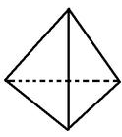
C3: Localization Scheme
Generating to 3-D case.
APs are likely to be deployed on the ceiling.
Is 4 AP sufficient in 3-D space in theory?
Client
AP1
AP2
AP3

Slide 18
C3: Localization Scheme
Scheme #1
Localization with geometric relation only.
Included Angles
Solid Angles
Cross Product Direction
Scheme #2
Estimating Rotation Matrix between two frames.
Using inertial sensors and compass on mobile phone.
Iteratively minimizing objective error function.

Slide 19
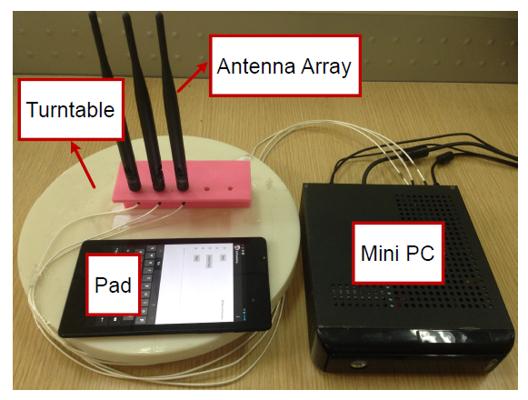
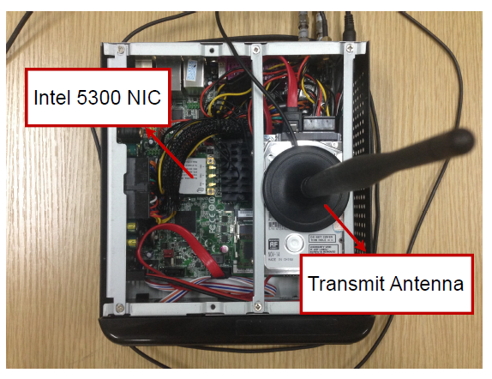

Preliminary Experiment
Experiment settings.
2-D scenarios.
Tx-Rx distance: 4m
Two types of arrays:
Uniform Linear Array
Right Angle Array
Rotation
Step: ${30}^{°}$
Range: $0\sim {360}^{°}$
Rx
Tx

Slide 20
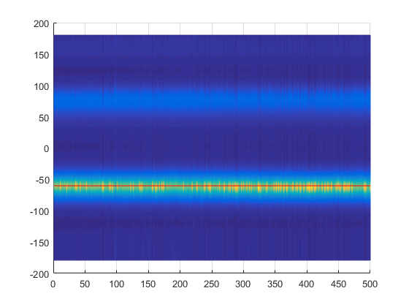
Preliminary Experiment
Single estimation is unstable, while multiple estimation yields reliable results.

Slide 21

Preliminary Experiment
Possible Solution
For each measurement, obtain p packets.
Totally $p^{n+1}$ possible combinations.

Slide 22
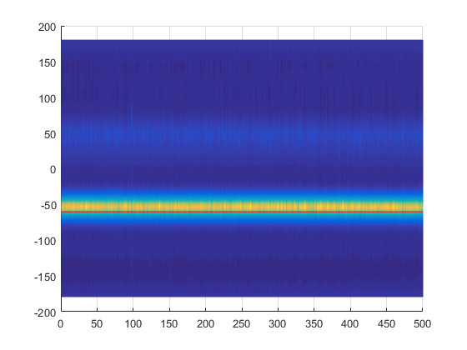
Preliminary Experiment
The more rotations and measurements performed, the better results is.
Two Rotations
Four Rotations

Slide 23
Preliminary Experiment
Two observations:
Theoretically, two rotation is sufficient.
Not all CSIs have good quality.
Possible solution.
Combine each 2-tuple for AoA estimation and then perform majority voting.

Slide 24
Todo
1. Figure out if the AoA model is correct…
2. Find efficient AoA estimation algorithm.
3. Figure out the least number of anchors for 3-D localization and give a proof.
4. Finding tricks to increase estimation accuracy with multiple packets and multiple rotations.
5. Enrich experiments.
Compose a hand-held mobile device with both antennas and gyroscope sensors that are synchronized.
Deploy Aps (or Mini-desktops) in lab.

