Slide 1
Eliminate the impact of interfering radios on CSI
Yue zheng
Tsinghua university

Slide 2
Background
Wi-Fi: 2.4-2.4835GHz/5.150-5.850GHz
Cordless Phone: 2.4-2.5GHz/5.725-5.875GHz
Bluetooth: 2.4-2.4835GHz
Microwave oven: 2.4GHz
ZigBee:2.4-2.4835GHz
Too Crowded!
External interfering radios

Slide 3
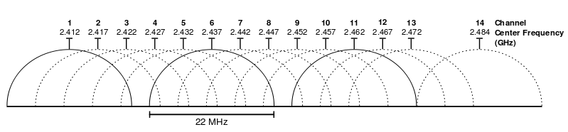
Background
Adjacent Channel Interference
Co-channel Interference

Slide 4
Motivation
External Interference:
Bluetooth/ZigBee/Microwave oven…
Radio Frequency Interference
Internal Interference:
Adjacent channel & Co-channel
If the signal we get is interference-free, it can be better utilized in localization/sensing….
Eliminate the impact of interference on CSI by signal processing

Slide 5
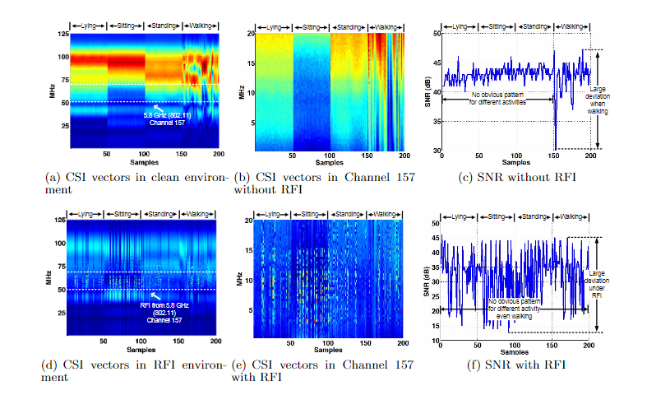
Related Work
Radio-based Device-free Activity Recognition with Radio Frequency Interference(IPSN’15)
investigate the impact of RFI on device-free CSI-based location-oriented activity recognition
propose a novel fusion algorithm that can improve the recognition performance of the systems by up to 10% when RFI is present
final CSI = target CSI + interference CSI

Slide 6
Related Work
On Cyclostationary Analysis of Wi-Fi Signals for Direction Estimation(ICC’15)
MobTrack: Locating Indoor Interfering Radios With A Single Device(Infocom’16)
DOF: A Local Wireless Information Plane(SIGCOMM’11)
PinPoint: Localizing Interfering Radios(NSDI’13)
They all focus on the cyclostationary property of the signals.

Slide 7

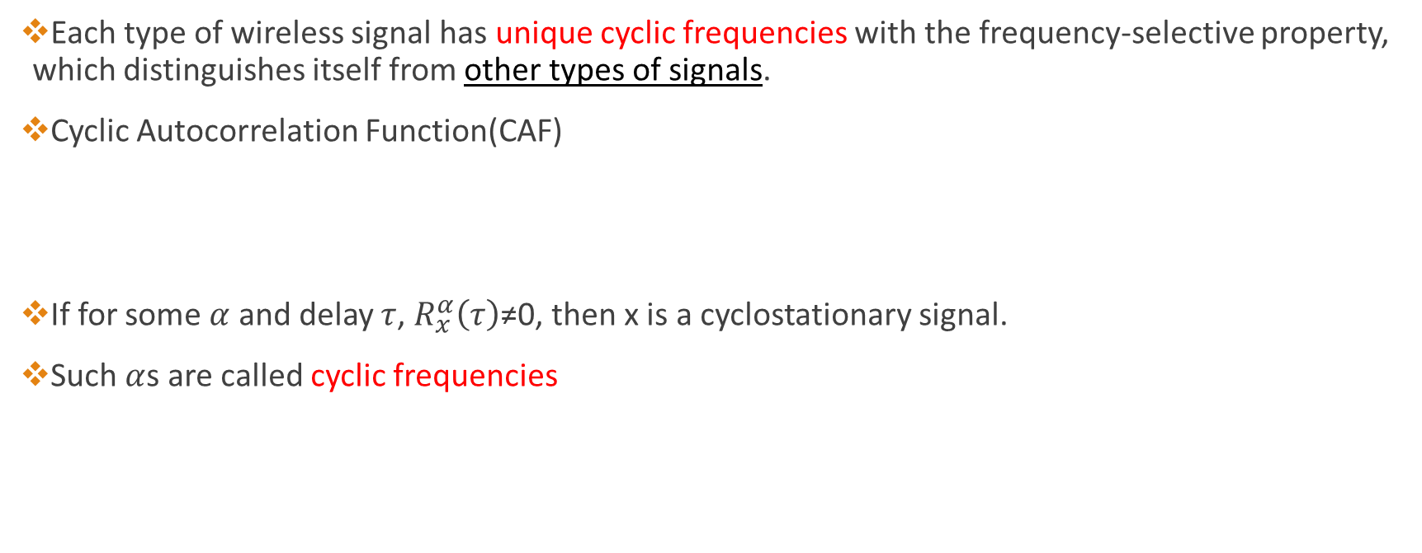

Cyclostationarity
Each type of wireless signal has unique cyclic frequencies with the frequency-selective property, which distinguishes itself from other types of signals.
Cyclic Autocorrelation Function(CAF)
If for some $α$ and delay $τ$, $R_{x}^{α}\left(τ\right)$≠0, then x is a cyclostationary signal.
Such $α$s are called cyclic frequencies
$$<∙> ≜ \lim_{T→∞}{\frac{1}{T}\int_{\frac{−T}{2}}^{\frac{T}{2}}{\left(∙\right)dt}}$$
$$R_{x}^{α}\left(τ\right)≜ <x\left(t+\frac{τ}{2}\right)x^{∗}\left(t−\frac{τ}{2}\right)e^{−j2παt}>$$

Slide 8
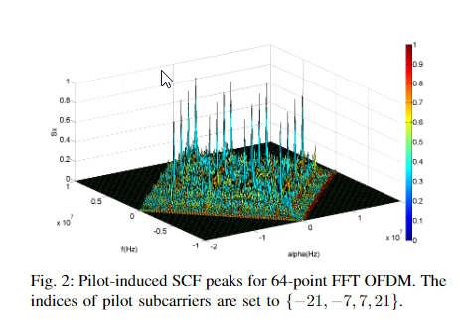


Cyclostationarity
Spectral Correlation Density(SCD): the Fourier transform of CAF
Coordinate ($α$,f)
Different types of signals have different peak patterns on the SCD surface due to different modulation method, carrier frequency and frame structure.
$$s_{x}^{α}\left(f\right)= \int_{−∞}^{∞}{R_{x}^{α}\left(τ\right)e^{−j2πfτ}dτ}$$

Slide 9
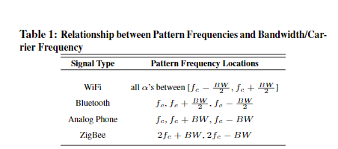
Cyclostationarity
Select a cyclic frequency that is unique to the interfering radios, calculated CAF and SCD is external interference-free.

Slide 10

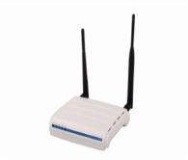
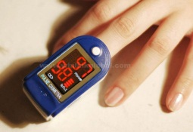
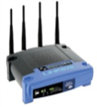


How would we build a smart radio which coexists with legacy devices?
Knowledge of
The protocol types operating in the local vicinity
2. The spectrum occupancy of each type
3. The spatial directions of each type
180°
WiFi AP
Heart Monitor
180°
AoA
AoA
0°
0°
2.3 GHz
2.5 GHz
2.3 GHz
2.5 GHz
2.3 GHz
2.5 GHz
2.3 GHz
2.5 GHz
Freq
Freq
Freq
Smart Transmitter
Smart Receiver
Freq
Microwave
10

Slide 11




DOF: High Level Architecture
MAC
DOF
$$\{Θ,Type, F_{c},BW\}_{n=1}^{N}$$
DOF operates on windows of raw time samples from the ADC
$$\{Θ\}_{n=1}^{N}$$
DOF Estimation
(AoA Detection)
$$\{Type, F_{c},BW\}_{n=1}^{N}$$
Raw samples are processed to extract feature vectors
DOF Estimation
(Spectrum Occupancy)
Feature Vectors are used to detect
Signal Type
Spectral Occupancy
Spatial Directions
$$\{Type, \vec{F} (i){ \}}_{n=1}^{N}$$
Classification
Feature
Extraction
The MAC layer utilizes this mechanism to inform its coexistence policy
Time Samples
Signal
ADC
11

Slide 12
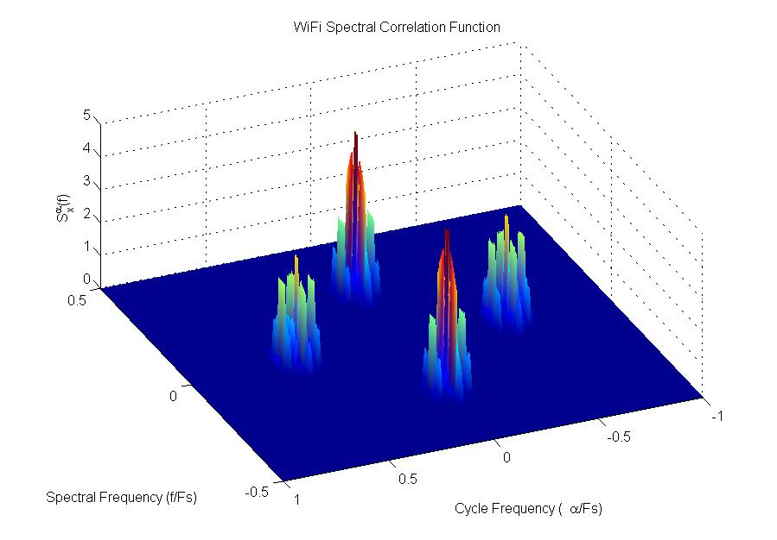
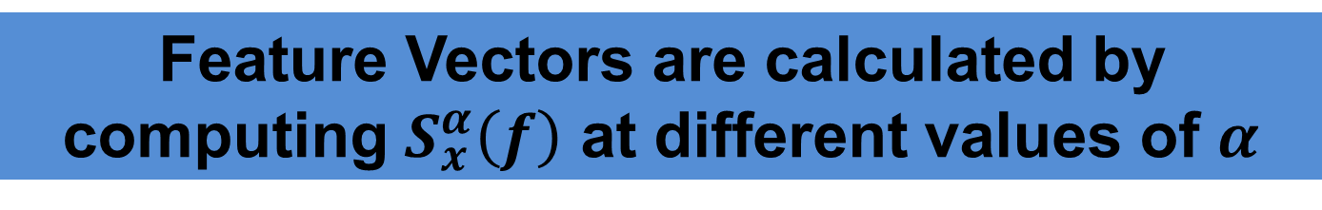
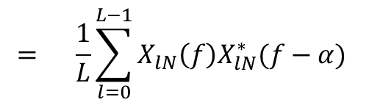
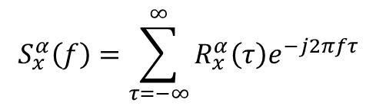
Feature Extraction: Efficient Computation
The CAF can be represented using an equivalent form called the Spectral Correlation Function (SCF)
$$S_{x}^{α}\left(f\right)=\sum_{τ=−∞}^{∞}{R_{x}^{α}\left(τ\right)e^{−j2πfτ}}$$
$$= \frac{1}{L}\sum_{l=0}^{L−1}{X_{lN}\left(f\right)X_{lN}^{∗}(f−α) }$$
WiFi Spectral Correlation Function
SCF can be calculated for Discrete Time Windows using just FFTs
Feature Vectors are calculated by computing $S_{x}^{α}\left(f\right)$ at different values of $α$
Frequency (f)
Pattern Frequency (α)
12

Slide 13




Multiple interfering signals are not straightforward to classify
Multiple signals are made up of components and features of single signals, making them difficult to distinguish
Feature Dimension 2: $S_{x}^{α_{2}}\left(f\right)$
Feature Dimension 2: $S_{x}^{α_{2}}\left(f\right)$
Feature Dimension 1: ${ S}_{x}^{α_{1}}\left(f\right)$
Feature Dimension 1: ${ S}_{x}^{α_{1}}\left(f\right)$
Need a robust algorithm to determine the number of interfering signals
13

Slide 14
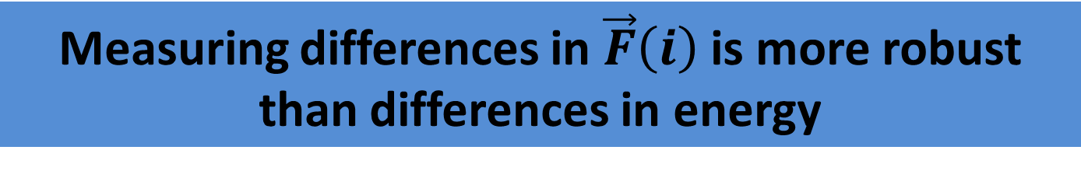
Inferring the number of signals: Exploiting Asynchrony
1) Real signal packets are asynchronous
2) This asynchrony shows up in as an increase or decrease in the
number of non-zero components
Received Signal
Overlapping Packets
ZigBee
WiFi
Nonzero Components in
t
Measuring differences in $\vec{F}\left(i\right)$ is more robust than differences in energy
14

Slide 15
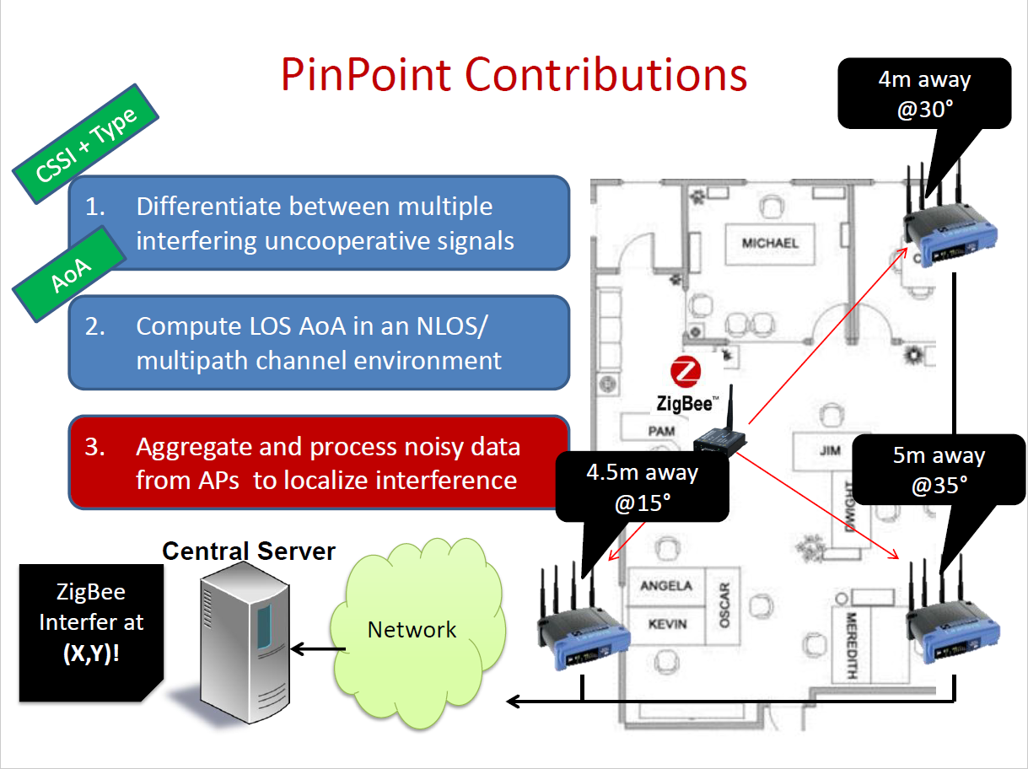

Slide 16
On Cyclostationary Analysis of Wi-Fi Signals for Direction Estimation(ICC’15) MobTrack: Locating Indoor Interfering Radios With A Single Device(Infocom’16)
Study the cyclostationary property of IEEE 802.11(Wi-Fi) signals induced by pilots, cyclic prefix, and preambles.
Simulation results how that the pilot-induced cyclostationary property of Wi-Fi signals is a promising feature that can be used to solve the signal-selective direction estimation.
Cyclic-MUSIC Algorithm
One interfering radio

Slide 17
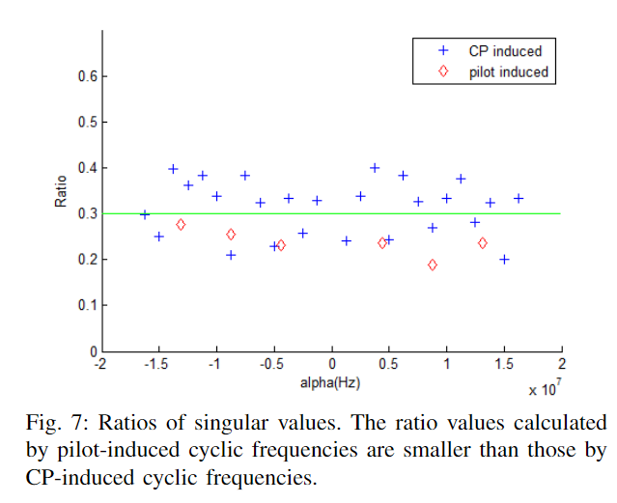
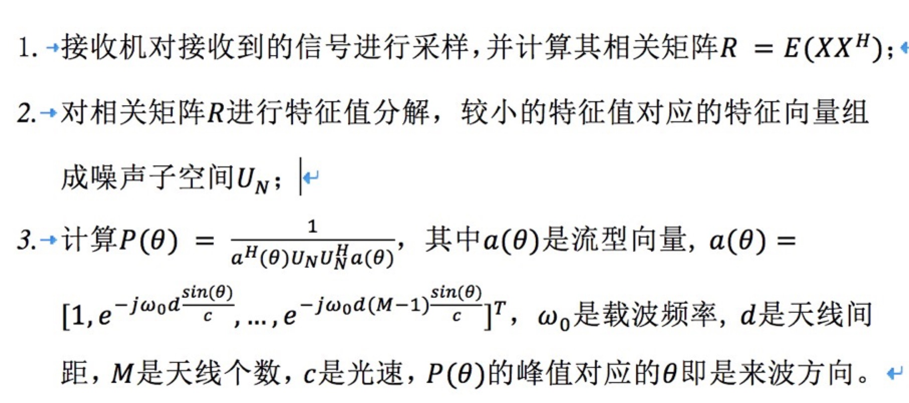
Cyclic-MUSIC

Slide 18
To Do
External Interference:
Bluetooth/ZigBee/Microwave oven…
Cyclostationarity
Radio Frequency Interference
Internal Interference:
Adjacent channel & Co-channel
?
CSI’ or Better Feature or CIR’ or PDP’…..
Different Applications

Slide 19
To Do
Verify the impact of interfering radios on CSI/CIR/PDP….
Tx/Rx: USRP
Interference: Bluetooth/ZigBee
Propose algorithms to get features without external and adjacent-channel interference
based on cyclostationarity of Wi-Fi signals
mitigate the impact of adjacent-channel interference by ….
Implement algorithms and use COTS devices to do AOA/Activity Recognition/LOS identification…

Slide 20
Challenge
Theoretical:
Algorithms!
Especially how to mitigate the impact of adjacent-channel interference…
Practical:
Experimental environment
Maybe there exist many X factors…

