Slide 1
SoftLight: Adaptive Visible Light Communication over Screen-Camera Links
Wan Du, Jansen Christian Liando, and Mo Li
Nanyang Technological University, Singapore
Notes:
A Code; In Videos; Invisible to human; High-rate;

Slide 2
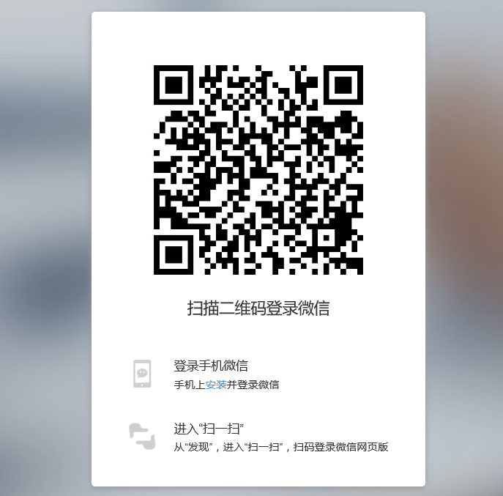
Background
Screen-Camera Links
Notes:
Security
Use video to transmit more message

Slide 3
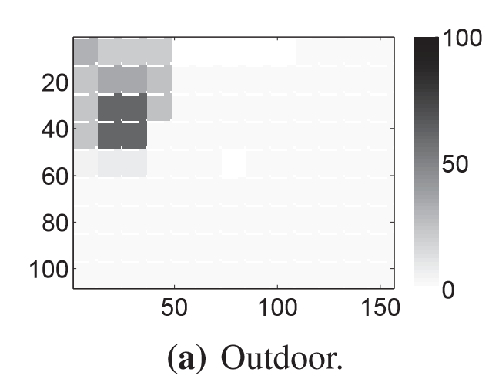
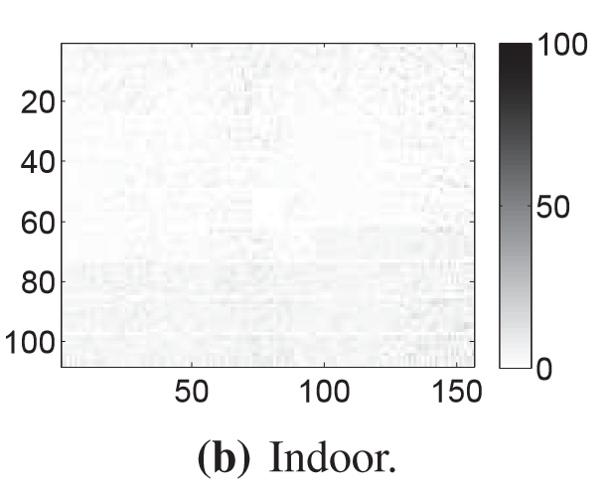
Motivation
Link Quality
Ambient Light
Camera
Distance and Angles
Trembling of User Hands
No feedback channel

Slide 4
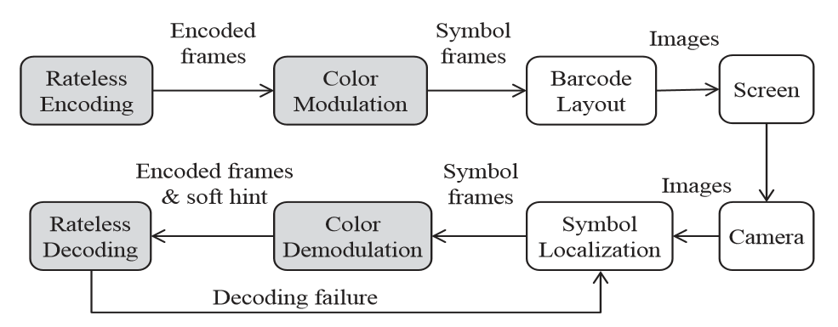
Design
Color Modulation
Rateless Encoding

Slide 5
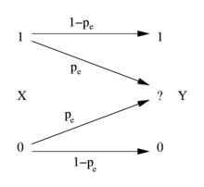
Preliminary
Erasure Channels
1 : 1
AWGN Channels
2 : 1
Notes:
Additive white Gaussian noise Channels

Slide 6
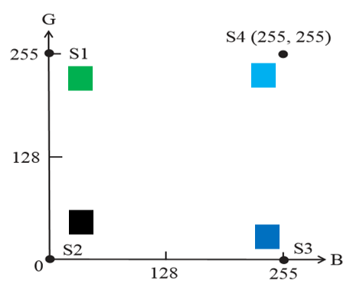
Color Modulation
Bits -> Symbol
10 (S1) -> 
11 (S2) -> 
01 (S3) -> 
00 (S4) -> 

Slide 7
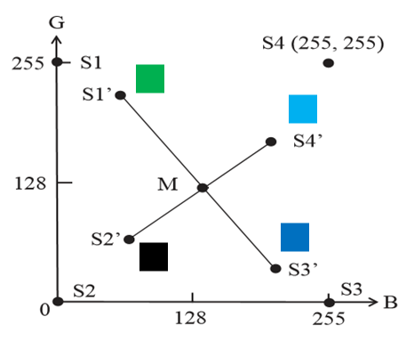
Color Modulation
Distortion
Color Palette

Slide 8
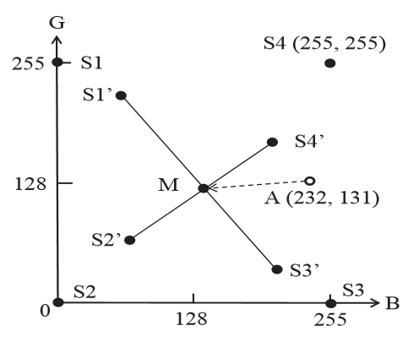

Color Modulation
Soft Hint
$SoftHint=\frac{MA}{MS_{k}^{′}}$
$k=arcmin\left|AS_{k}^{′}\right|$
$SoftHint≥τ :S_{k}$
$SoftHint<τ :E$

Slide 9
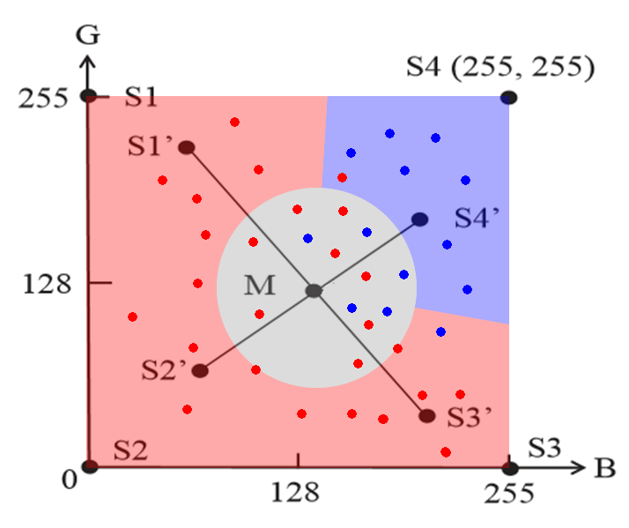

Color Modulation
$SoftHint≥τ$
and $S_{A}=S_{k}$
$SoftHint<τ$
and $S_{A}≠S_{k}$
$SoftHint≥τ$
and $S_{A}≠S_{k}$
False Positive
$SoftHint<τ$
and $S_{A}=S_{k}$
False Negative

Slide 10
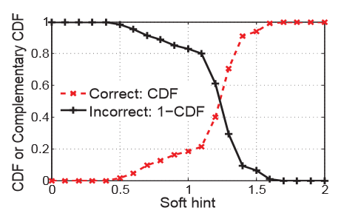

Color Modulation
Choose Threshold $τ$
$τ=$1.35
BER: 4.5%
False Positive: 1.0%
False Negative: 76.4%
76.4% is too high!
Notes:
False Positive: error -> not erased
False Negative: correct -> erased

Slide 11
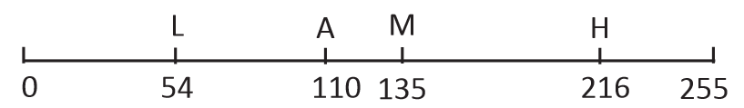
Color Modulation
Each dimension as a channel
One dimensional SoftHint

Slide 12
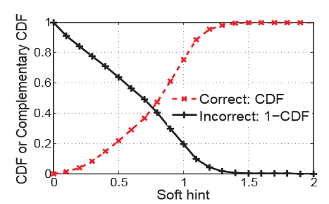

Color Modulation
Choose Threshold $τ$
$τ=$ 0.8
BER: 2.8%
False Positive: 0.8%
False Negative: 58.3%
Looks better. Then?...
Notes:
False Positive: error -> not erased
False Negative: correct -> erased

Slide 13
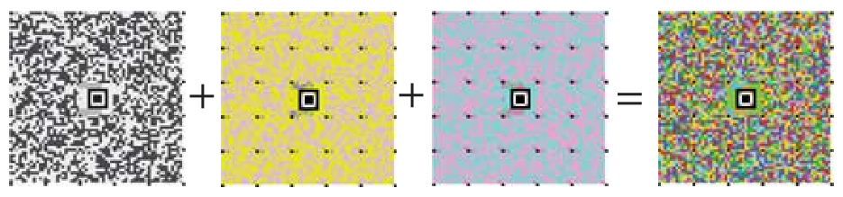
Color Modulation
Change color space
RGB -> YUV

Slide 14
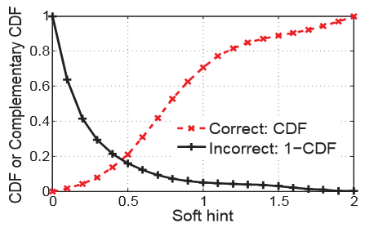

Color Modulation
Choose Threshold $τ$
$τ=$ 0.2
BER: 2.3%
False Positive: 0.9%
False Negative: 4.9%
Looks better. Then?...
Notes:
False Positive: error -> not erased
False Negative: correct -> erased

Slide 15
Color Modulation
Special color palette
     
↑ ↑

Slide 16
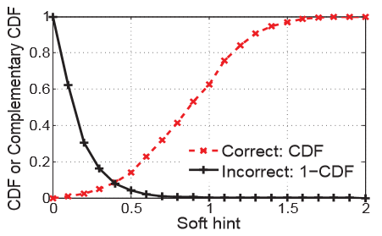

Color Modulation
Choose Threshold $τ$
$τ=$ 0.15
BER: 2.2%
False Positive: 0.8%
False Negative: 1.8%
Looks better. Then?...
Notes:
False Positive: error -> not erased
False Negative: correct -> erased

Slide 17

Color Modulation
Choose Threshold $τ$
$τ=$ 0.15
BER: 2.2%
False Positive: 0.8%
False Negative: 1.8%
Looks better. Then?...
Notes:
False Positive: error -> not erased
False Negative: correct -> erased

Slide 18
Design
Color Modulation
Rateless Encoding

Slide 19
Rateless Encoding
Challenges
Not perfect erasure channels (False Positive > 0)
Solution
Mixed encoding (erasure + AWGN)

Slide 20
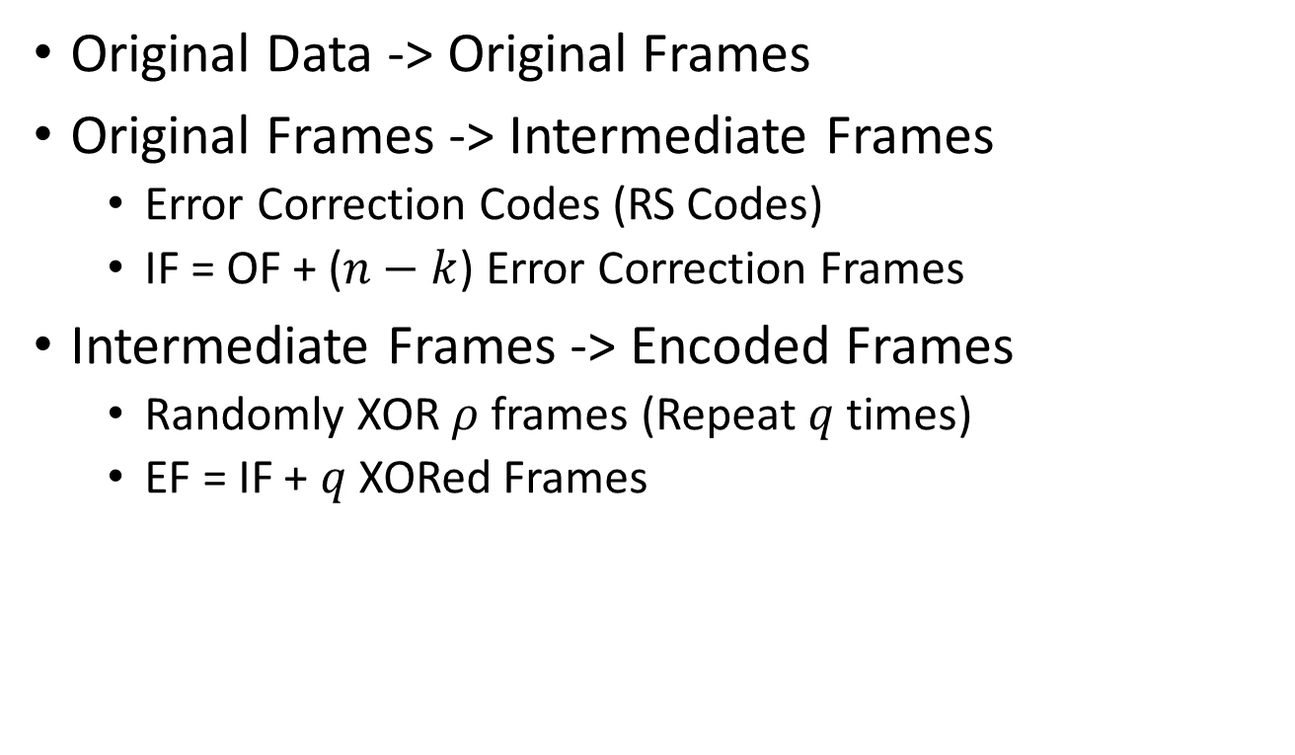
Encoding
Original Data -> Original Frames
Original Frames -> Intermediate Frames
Error Correction Codes (RS Codes)
IF = OF + ($n−k$) Error Correction Frames
Intermediate Frames -> Encoded Frames
Randomly XOR $ρ$ frames (Repeat $q$ times)
EF = IF + $q$ XORed Frames
Notes:
Reed-Solomon

Slide 21
Encoding
X1 X2
P1 = RS(X1 X2)
Y1 Y2 Y3 = X1 X2 P1
Y4 = X1 ⊕ X2
Y5 = X2 ⊕ X3
Y6 = X1 ⊕ X3
Notes:
Reed-Solomon

Slide 22
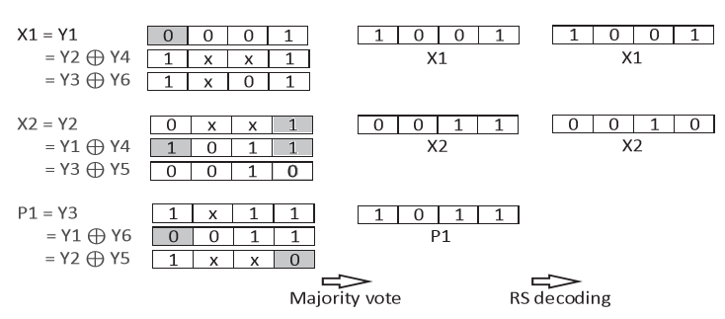
Decoding
Encoded Frames -> Intermediate Frames
Calculate multiple results
Vote

Slide 23
Decoding
Intermediate Frames -> Original Frames
Error Correction

Slide 24
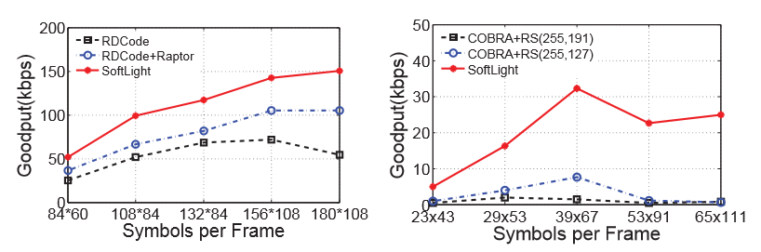
Evaluation
Comparison with COBRA & RDCode

Slide 25
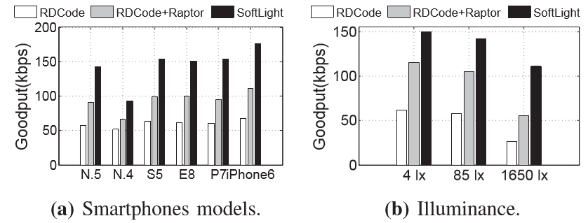
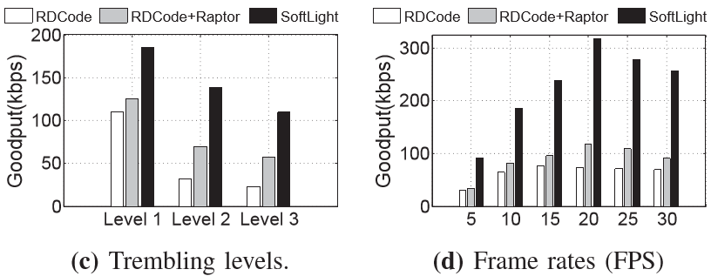
Evaluation

Slide 26
Conclusion
SoftLight enhanced visible light communication between screen and camera
Color Modulation
Rateless Encoding Scheme
SoftLight achieves high throughput

Slide 27
Thank you!
Q & A

