Slide 1
High-Rate Flicker-Free Screen-Camera Communication with Spatially Adaptive Embedding
Viet Nguyen and Yaqin Tang (WINLAB, Rutgers University, USA)
Ashwin Ashok (Carnegie Mellon University, USA)
Marco Gruteser (WINLAB / Rutgers University, USA)
Kristin Dana (Rutgers University, USA)
Wenjun Hu (Yale University, USA)
Eric Wengrowski (Rutgers University, USA)
Narayan Mandayam (WINLAB, Rutgers University, USA)
Presented by Kai Zhang

Slide 2
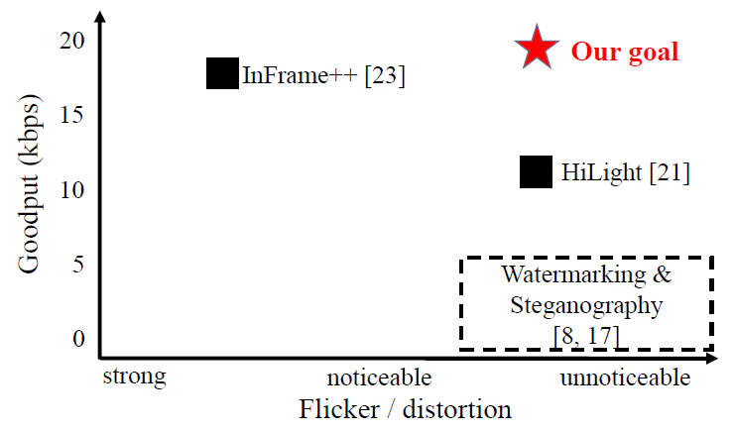
INTRODUCTION
Notes:
While there have been a few existing efforts on embedded
screen-camera communications, they tend to achieve either
high throughput but noticeable flicker or virtually flicker-free
embedding but low throughput, as illustrated in Fig. 1. In
particular, InFrame++ [23] utilizes the flicker fusion property
of the human visual system to embed data. It relies on high
screen refresh and camera frame rates to modulate the image
at rates faster than the human eye can perceive. It can therefore
transmit data at 18 kbps, but noticeable flicker remains.
HiLight [21] modulates bits through slight pixel translucency
changes, which reduces flicker to unnoticable levels but only
supports a low bit rate.

Slide 3
INTRODUCTION
Our Work:
Exploring psychovisual factors leading to flicker perception.
Uncovering additional dimensions of the flicker-free embedding design space.
Studying adaptive spatial encoding in the screen-camera communication channel.

Slide 4
FLICKER PERCEPTION FOR EMBEDDED COMMUNICATION
Frame rate
Image content
Saccades
Viewer’s field of view

Slide 5
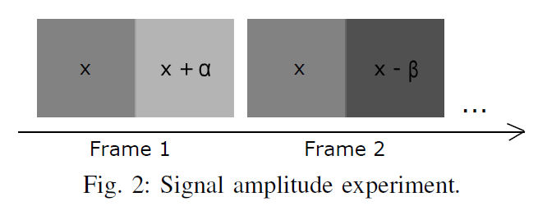
FLICKER PERCEPTION FOR EMBEDDED COMMUNICATION
Frame rate
The left block has a fixed intensity value x, while the right block’s color flips between x+α and x-β at 120 fps.
Experiments show that the color deviation without inducing flicker perception is α = 2 and β = 3.

Slide 6
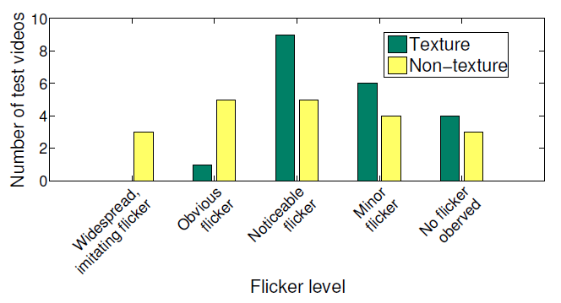
FLICKER PERCEPTION FOR EMBEDDED COMMUNICATION
Image content
Human vision is sensitive to even small intensity edges and that texture affects the perception of intensity transitions.
Intensity modifications in smooth regions are more likely to cause flicker than textured regions.

Slide 7




FLICKER PERCEPTION FOR EMBEDDED COMMUNICATION
Saccades
However, separating the blocks with some distance can reduce or minimize the effect.

Slide 8
FLICKER PERCEPTION FOR EMBEDDED COMMUNICATION
Viewer’s field of view
The smaller block size or further distance, the less flicker the viewer perceives.
This suggests using only small code blocks for encoding and avoiding parts of the image scene that might attract attention.

Slide 9
FLICKER PERCEPTION FOR EMBEDDED COMMUNICATION
Hints for code design
The first three factors are orthogonal, paving way for combining the corresponding techniques leveraging the factors.
Frame rate is a temporal property of the video, whereas the image content and saccades mostly affect the spatial domain.
Based on these insights, we design TextureCode to achieve high capacity at negligible flicker.

Slide 10
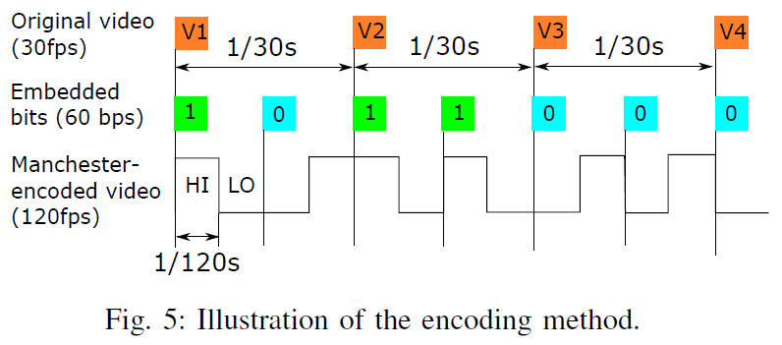
SPATIAL-TEMPORAL EMBEDDING
Temporal embedding
We choose a Manchester-like encoding scheme for modulating bits, to keep the frequency components of the encoded video signal above 60 Hz.

Slide 11
SPATIAL-TEMPORAL EMBEDDING
Spatial embedding based on texture analysis
Texton analysis
Pixel-based texture analysis

Slide 12
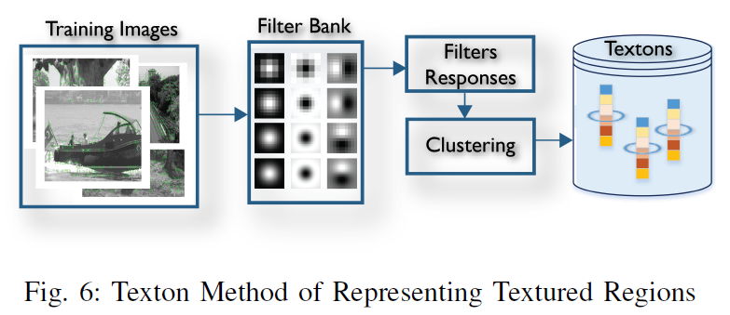
SPATIAL-TEMPORAL EMBEDDING
Texton analysis
We model texture as a distribution of textons, which is, more exactly, the histogram of textons.

Slide 13
SPATIAL-TEMPORAL EMBEDDING
Texton analysis
Next, we continue use K-mean clustering to divide our training set of texton histograms into groups.
Then, each texton histogram group is labeled “good” if the videos have low flicker , and“bad” otherwise.
Each new block of an input video is pre-processed to compare its texton histogram with our training set of texton histograms to find its label (“good” or “bad”).

Slide 14
SPATIAL-TEMPORAL EMBEDDING
Pixel-based texture analysis
This pixel-based texture analysis is based on the variations of spatial pixel intensities. A larger variation value indicates a more textured region.

Slide 15
SPATIAL-TEMPORAL EMBEDDING
Superpixels
It belongs to over-segment techniques: an image is divided into sub-regions with respect to image edges, and pixels inside each region are uniform in color and texture.
To generate superpixels, we use SLIC (Simple Linear Iterative Clustering) algorithm, which is fast and has high segmentation performance.
This technique would ensure: (1) Separate the encoded regions (i.e., get rid of edges between them), and (2) align the border of each encoded region to the existing edges in the original frame.
We propose a block-superpixel hybrid encoding method to know the location of each super pixel.

Slide 16
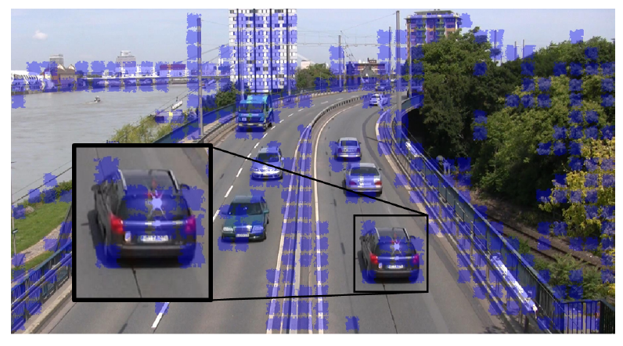
SPATIAL-TEMPORAL EMBEDDING

Slide 17
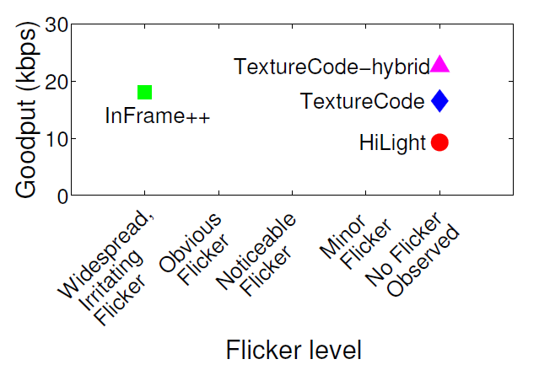
EVALUATION

Slide 18
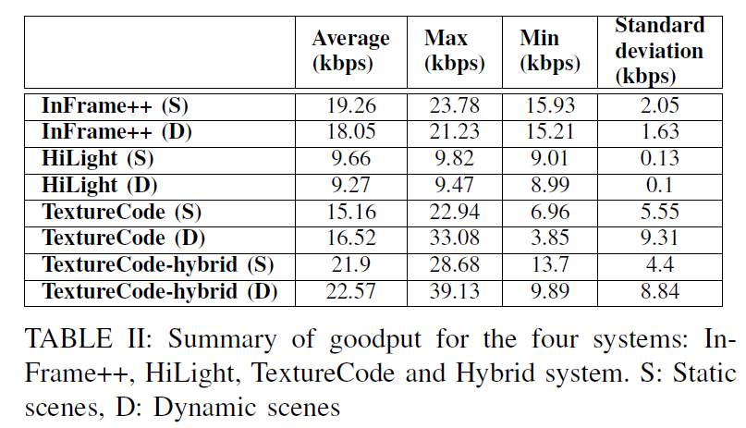
EVALUATION

Slide 19
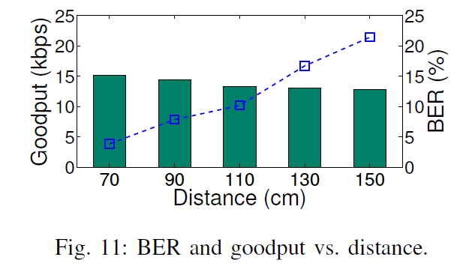
EVALUATION

Slide 20
我的评价
本论文最大的贡献是提出了一种基于纹理的寻找“适合编码的区域”的思路
以往的工作往往局限于独立提出一种编码方案，而没有太在意其局限性和不足之处
对我们的工作的启示：在适合的位置编码

Slide 21
Thank you!

