Slide 1

Enhancing Smartphone Indoor Localization via Opportunistic Sensing
Kaikai Liu (San Jose State University) Di Wu (Hunan University) Xiaolin Li (University of Florida)
Presented by Tianmeng Hang

Slide 2


Author Introduction
2016 IEEE SECON
Best Paper Award
Kaikai Liu
Computer Engineering, Doctor of Philosophy (Ph.D.)
Gainesville, Florida Area
2011 – 2015
ZaiNar (2012-
An Indoor Location
Based
Service System
中科院
01

Slide 3

Problem
Problems of Indoor Localization
At least THREE anchors
Human moving
02

Slide 4
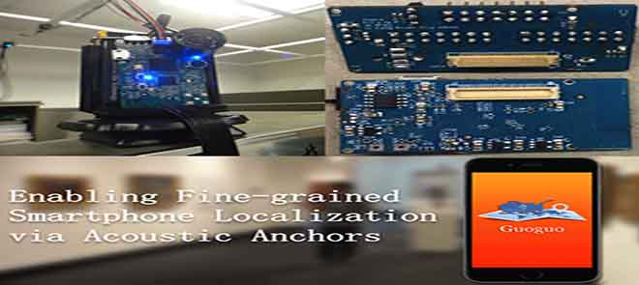

Motivation
Acoustic anchor-based solution
(centimeter-level accuracy)
exploring more data types rather than more anchor nodes
03

Slide 5

Motivation
ranging information
relative angle information
displacement and moving direction
04

Slide 6
System Design
BLE signal and Acoustic signal
05
Notes:
0.信号主要有两种：声音信号和BLE信号
蓝牙低能耗技术
1.BLE 用于RSS测距。和wifi比省电高效率
2.防止手机运算量过大，使用一个服务器进行复杂算法的运算 delay ≤ 100ms

Slide 7
Three Keys
1
Ranging Information
2
Angle information
3
Displacement &
moving direction
06

Slide 8



Acoustic TOA-based Ranging (fine grained)
s_{b}
s_{a}
t_{m}
07
Notes:
Clock drift 时钟偏移
使用凸优化的方法降低clock drift的误差

Slide 9

RSS based Ranging (coarse grained)
vs
Changing：1.5~20 meters
Step size：0.762 meters
08
Notes:
Received Signal Strength Indication接收的信号强度
覆盖率和NLOS的健壮性方面，还是BLE beacon强
如果 声音RSS 获得不了，需要BLE来替。
Thus, the RSS ranging result rˆn,m is a combined value from BLE and acoustic signal.

Slide 10
Ranging
TOA Ranging vs RSS Ranging
09

Slide 11
Three Keys
1
Ranging Information
2
Angle information
3
Displacement &
moving direction
10

Slide 12
Angle Information
High directionality
11

Slide 13
Three Keys
1
Ranging Information
2
Angle information
3
Displacement &
moving direction
12

Slide 14
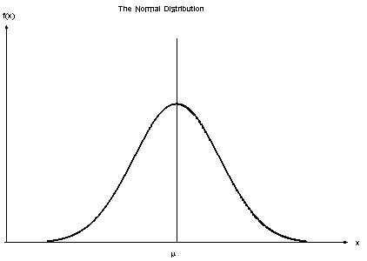

Displacement Estimation
Bias Error
Accelerometer
Movement Model:
Start-Moving-Stop Pattern
13
Notes:
使用手机自带的加速传感器

Slide 15

Process
14

Slide 16
Experiment
Device: iPhone 5s
Anchor max distance:20cm
m=1,2
❗️2~11 times
15
Notes:
实验环境： 最大距离为20m，8个anchor
Initial 低耗能蓝牙技术

Slide 17
Trilateration via Semidefinite Programming
16
Notes:
Rmse:与实际测量值差的平均值的开方

Slide 18

在此输入标题
“
“
谢谢大家，请提问！
输入文字
在此录入上述图表的综合分析结论
在此录入上述图表的综合分析结论
在此录入上述图表的综合分析结论
在此录入上述图表的综合分析结论

