Slide 1
Turning a Mobile Device into a Mouse in the Air
Sangki Yun, Yi-Chao Chen and Lili Qiu
Department of Computer Science
The University of Texas at Austin
ACM MobiSys 2015, Florence, Italy

Slide 2

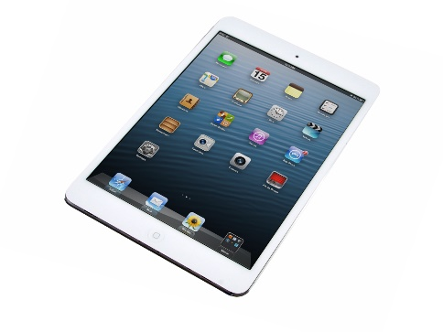
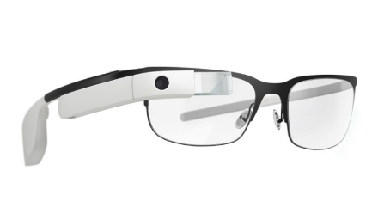
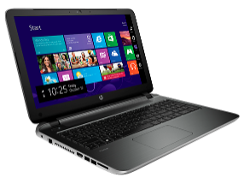
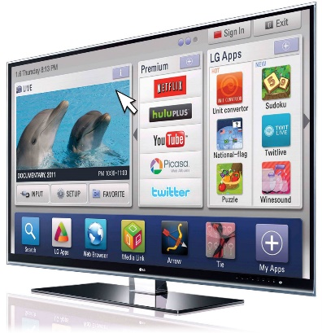
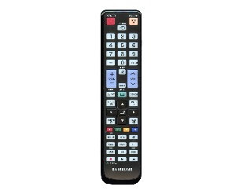
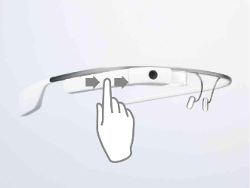
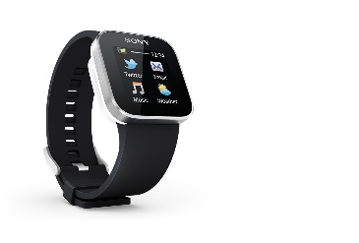
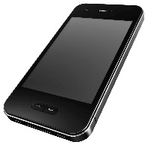
Era of Smart Devices
Smart Devices
Notes:
These days, people are surrounded by smart devices such as smart phone, laptop, smart TV and smart watch. According to some survey, a person carriers 2.9 smart devices in average. For some of the smart devices, they require sophisticated user interface to fully utilize the functionality, but the provided controller is not sufficient. For example, with smart TV, we can do almost all things we do with laptop or tablet such as web-browsing, social network and gaming, but the traditional remote controller is not good enough to utilize them. Similarly, smart glasses usually has small touch pad and we can use it to make a few simple commands such swiping and tapping, but the number of distinct gestures are limited and it significantly reduces the usability of the smart glasses.

Slide 3
Our goal
Controlling smart devices using existing mobile devices
How to enable precise mobile device position tracking?

Slide 4
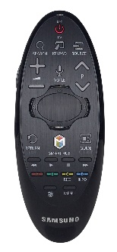
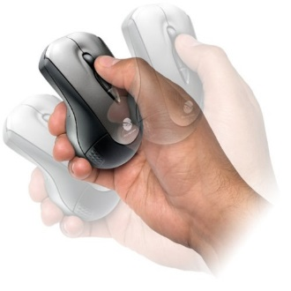
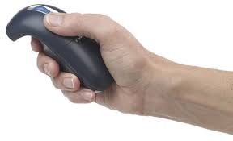
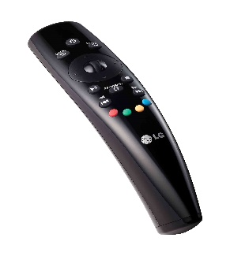
Possible solutions
WiFi signal based device localization – sub-meter level accuracy
Accelerometer based device tracking – not feasible due to large error
Gyroscope – track the rotational movement of the device
Notes:
In order to track the device movement, one possible way is using RF signal, which is very popular in indoor localization. However, it only achieves sub-meter level accuracy which our application requires cm level accuracy. Another possible way will be using the accelerometer in the mobile device. If the device is moving, the acceleration is generated and we can use it to track the position. However, the measured acceleration has huge noise and the tracking is not feasible. Using the gyroscope, we can track the rotational movement of the device. It is indeed used for commercial air mouse products and remote controllers for smart TVs. The problem of this approach is it tracks the rotational movement of our wrist while the mouse pointer is moving is 2D plane. The disparity between the rotational movement and 2D movement makes the users experience difficulties in controlling the pointer using gyroscope.

Slide 5
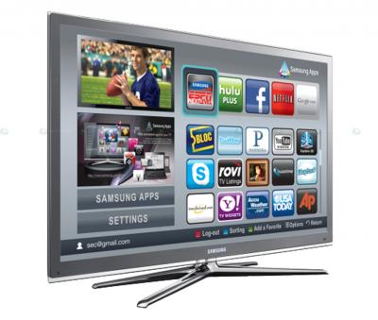
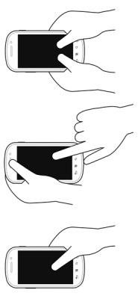
Our Approach
Audio based movement tracking using Doppler effect
Speakers emit audio signals in inaudible frequencies
The device position is tracked by the Doppler shift of the recorded audio signal
Notes:
In this work, we track the device movement using the audio signal. In particular, we use the Doppler shift generated while the device is moving. Here, the device to be tracked has two speakers, and each speaker emit pure sinusoid tones in different inaudible frequencies. The mobile device records the audio signal and sends it back to the processor, where it tracks the movement by analyzing the Doppler shift.

Slide 6
Why not accelerometer?
Small hand vibration causes non-negligible error
Track the device position by double integration of the acceleration
Quick error accumulation
Movement estimated from the accelerometer
Measured acceleration

Slide 7
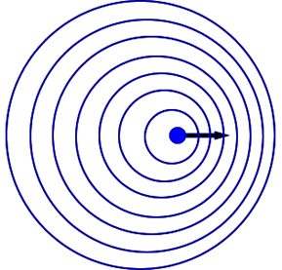
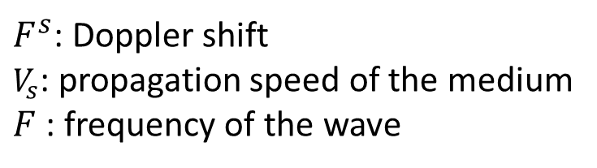
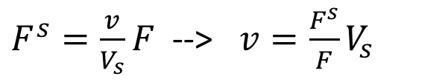
Doppler Effect
Doppler shift – change in the frequency due to the movement of the sender or the receiver
$F^{s}=\frac{v}{V_{s}}F$ --> $v=\frac{F^{s}}{F}V_{s}$
$F^{s}$: Doppler shift
$V_{s}$: propagation speed of the medium
$F$: frequency of the wave
Lower
frequency
Higher
frequency
Notes:
Doppler shift is the change of the center frequency incurred by the movement of the sender or the receiver of the wave signal. The mathematical relationship between the velocity and the frequency shift is like this. Let’s say the sender position is the fixed. The propagation speed and the center frequency of the original wave is constant, so by observing the frequency shift, we can calculate the velocity of the receiver.

Slide 8
Doppler based device tracking
From the measured Doppler shift, we can get the velocity and the moving distance of the device
`
Measured Doppler shift
Movement estimated
from Doppler shift
Notes:
Regarding the device tracking, one might wonder why don’t we simply use accelerometer instead of the Doppler. Accelerometer is equipped in almost all smart phones, and it is very cheap to read the acceleration in terms of the energy efficiency. However, the accelerometer has two fundamental problems. One is that it is easily affected by the gravity so small hand vibration causes non-negligible acceleration. And it tracks the position by the double integration where one integration of the acceleration gives the velocity and another integration gives the position. It is very sensitive to noise and small acceleration measurement error quickly explodes over time. Here we measure the acceleration while the device is moving in one direction. We see that the difference while the device is moving and stopped is small. And because of the accumulated error, the tracked position infinitely goes wrong direction even if the device has stopped. On the other hand, in the measured Doppler shift, we can clearly tell when the device is moving, and the movement distance tracked by the Doppler is much more accurate than the Doppler.

Slide 9
Outline
Accurately estimate the Doppler shift
Locate the device
Finding the distance between speakers
Handling the uncertainty of the initial position
Notes:
In order to enable Doppler shift

Slide 10
Outline
Accurately estimate the Doppler shift
Locate the device (Assume speaker distance & initial position known)
Finding the distance between speakers
Handling the uncertainty of the initial position
Notes:
In order to enable Doppler shift

Slide 11
Doppler shift estimation
Frequency domain analysis by Short-term Fourier Transform (STFT)
Detect the Doppler shift by finding the peak frequency with maximum magnitude
Spectrogram of the audio signal
Doppler shift estimated by peak detection
Notes:
To estimate the Doppler shift, we need to analyze the signal in the frequency domain. Given the received audio signals, we perfom STFT to observe the change of the spectrum over time, and we estimate the Doppler shift by finding the frequency with the maximum magnitude. This is the spectrogram we got from STFT while device is drawing a circle. This is the Doppler shift estimated by the peak detection. By itself it has significant error so the tracking is inaccurate.

Slide 12
Improving the frequency shift estimation accuracy
Utilize larger spectrum
Send multiple audio tones in 200 Hz interval
Outlier removal
Doppler shift change larger than 10 Hz
Maximal Ratio Combining
Doppler shift from multiple channels
MRC with outlier removal
Notes:
So we use several techniques to improve the accuracy. First, we use larger spectrum to estimate the Doppler shift. Instead of sending one audio, we send multiple tones in different frequencies and measures Doppler shift in multiple channels, which we can achieve diversity effect. Another observation is sometimes the measured Doppler error is unreasonably high and deviates Gaussian distribution. Considering the human hand movement speed limit, we can filter out the Doppler measurement samples where the difference from the previous measurement is significant. We regard the Doppler shift change larger than 10 Hz is measurement error and remove them. After that, we perform MRC that is widely used in receiver antenna diversity. This is the measured Doppler in 5 different frequencies. This is MRC result with and without outlier removal, and you can see the result with outlier removal is more smooth, which is likely to include less amount of error.

Slide 13
Outline
Accurate estimation of the Doppler shift
Locate the device (Assume speaker distance & initial position known)
Finding the distance between speakers
Handling the uncertainty of the initial position
Notes:
In order to enable Doppler shift

Slide 14
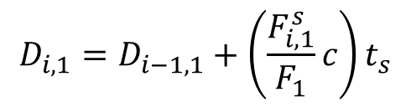
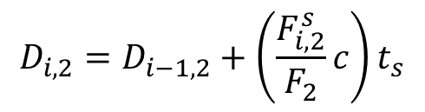
Tracking the device position - 1
Assumptions
The distance between speakers is known
The initial device position is known
Measure Doppler shift from two speakers
Using the previous position and Doppler, update new distance from speakers
$$D_{i,1}=D_{i−1,1}+\left(\frac{F_{i,1}^{s}}{F_{1}}c\right)t_{s}$$
$$D_{i,2}=D_{i−1,2}+\left(\frac{F_{i,2}^{s}}{F_{2}}c\right)t_{s}$$
Current distance
from speaker 1
Doppler sampling interval
Previous distance
from speaker 1
Change of the distance
tracked by Doppler
Notes:
Now I will explain how to track the position using the Doppler shift measurement. Here, I will first assume that the distance between speakers the device initial position are known, and later I will explain how to address the assumption. Given the Doppler shift estimation and the information on the current position, finding the new distance from the speakers is pretty simple. From the Doppler shift, we can calculate how much device has moved during the Doppler sampling interval, and by adding it to the previous distance. We can find the current distance from the two speakers.

Slide 15













Tracking the device position - 2
Having the distance from two speakers, finding the position is finding the intersection of two circles
$$(0,0)$$
$$(D,0)$$
$$D_{3,2}$$
$$D_{3,1}$$
$$(x_{4},y_{4})$$
$$D_{2,2}$$
$$D_{2,1}$$
$$(x_{3},y_{3})$$
$$D_{1,1}$$
$$(x_{2},y_{2})$$
$$D_{1,2}$$
$$(x_{1},y_{1})$$
$$(x_{0},y_{0})$$
Notes:
Once the distances from the two speakers are known, finding the position is finding the intersection of the two circles. Here I illustrate how to continuously track the device. For the tracking, we construct a virtual coordinate where the position of the left speaker is 0,0 and the position of the right speaker is D,0, and D is the distance between speakers. In each interval, the tracker measures the new distance from the speakers using the previous position information and Doppler shift. Using it, the tracker find the intersection of the two circles where the radius are the distance from the two speakers and the center points are the location of the speakers. In the next interval, it finds the new distances and the new position, and this is repeated until the tracking is completed.

Slide 16
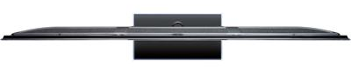




Finding the distance between speakers
Calibration to find the exact speaker distance using Doppler
Moves the device from left to right
T₁: $F_{s}^{1}$ changes from positive to negative
T₂: $F_{s}^{2}$ changes from positive to negative
Measure the distance using Doppler shift between T₁ and T₂
Speaker 1
Speaker 2
$$T_{1}$$
$$T_{2}$$
Notes:
Now I explain how to find the distance between the speakers. We provide a simple but effective calibration method that use can easily perform. Here, we again use Doppler shift to estimate the distance. During the calibration, the speakers are emitting the sound in inaudible frequency to estimate Doppler shift. The user goes close to the device to be tracked, and moves the mobile devices from left to right and come back to the left. From the measured Doppler shift, we can easily find the timing that the device passes the left and right speaker, because the Doppler shift changes from positive to negative. Then, we can easily find the distance from the measure Doppler shift between these two intervals.

Slide 17

Handling the uncertainty of the initial position (particle filtering)
Initially allocate many particles in a given space
In each movement update, remove particles that give infeasible movement (e.g., D < D₁ + D₂)
Update position by averaging the movement of all remaining particles
Repeat 2 and 3
$$P=\left\{\left(x_{o}^{1},y_{o}^{1}\right),…,\left(x_{o}^{N},y_{o}^{N}\right)\right\}$$
$$\left(x_{i+1},y_{i+1}\right)=\left(x_{i}+\frac{\sum_{k∈P}{\left(x_{i+1}^{k}−x_{i}^{k}\right)}}{\left|P\right|},y_{i}+\frac{\sum_{k∈P}{\left(y_{i+1}^{k}−y_{i}^{k}\right)}}{\left|P\right|}\right)$$
Notes:
The last part of the device tracking is how to find the initial position of the device. To address this problem, we use the particle filtering. Initially, we allocate many particles in large space where the device can potentially starts moving. Here each particle corresponds to the initial location of the device. In each movement, we update the position of the particle, and filter out the particles that make infeasible movements. Here, one example of infeasible movement is there’s no intersection of two circles when the device moves from the previous position. After that, we track the new position of the device by averaging all of the movements of the remaining particles. We repeat this until the device tracking is completed.

Slide 18
Implementation
We implement AAMouse to enable real-time device tracking
17 – 19 KHz frequency range
40 ms Doppler sampling interval
Comparison with
Accelerometer based tracking
Camera based tracking (ground-truth)
Gyroscope
Moves the pointer by rotational movement of the device

Slide 19
Performance evaluation
We performed user study with 8 students, and evaluated
Tracking accuracy (comparison with accelerometer)
Usability (comparison with Gyroscope)
Target pointing – show a target in the screen and ask the user to point it
Drawing – draw simple shapes such as heart, circle, diamond, triangle

Slide 20
Tracking accuracy
AAMouse
Median error: 1.4 cm
90th percentile error: 3.4 cm
Not affected by background noise
Accelerometer
Median error: 17.9 cm
90th percentile error: 37.7 cm
AAMouse achieves centimeter-level accuracy

Slide 21
Target Pointing evaluation
R=D_{a} / D_{s}
D_{a}: actual distance traveled
D_{s}: Distance between the target and the origin
Camera
AAMouse
AAMouse is easier to use than Gyroscope
Gyroscope
Samples from 80th percentile R

Slide 22
Drawing evaluation
Drawing error
The distance between original shape and the drawn image
Camera
AAMouse
Gyroscope
Samples from the 80th percentile drawing error

Slide 23
Limitation
Accumulation of the tracking error
Impact of multi-path
Possible solution: using additional information besides Doppler shift

Slide 24
Conclusion
We develop an audio based device tracking and apply it to realize mouse
Achieves centimeter-level accuracy
Requires no additional hardware
Future work
Improving the accuracy and robustness of the tracking

Slide 25

Thank you!
Come to see AAMouse in demo session!

Slide 27
Impact of using multiple sounds and outlier removal
With outlier removal
Without outlier removal

Slide 28
Impact of the speaker distance calibration
CDF of the speaker distance error
Trajectory error with various speaker distance errors

Slide 29
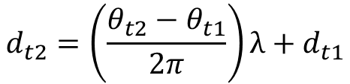
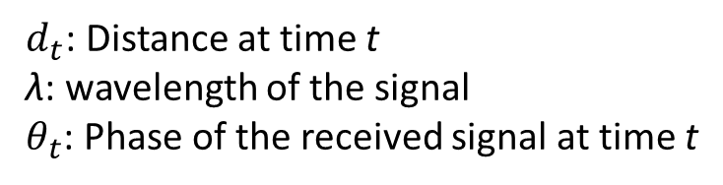
Controlling a device with one speaker
Leverage one speaker and one RF signal (WiFi or Bluetooth)
Measure the change of the distance from speaker using Doppler shift
Measure the change of the distance from RF source using phase change
Use the same mechanism to track the position
$$d_{t2}=\left(\frac{θ_{t2}−θ_{t1}}{2π}\right)λ+d_{t1}$$
$d_{t}$: Distance at time t
λ: wavelength of the signal
$θ_{t}$: Phase of the received signal at time t
Notes:
Until now, I have explained the tracking assuming that the tracker has two speakers, but in practice, there can be a device with one speakers such as small laptop and smart glasses. In such a case, we can leverage one RF signal to track the movement. Here, from one speaker, we measure the distance change using the Doppler shift. Also, we estimate the distance change from the RF source by observing the change of the phase. It is feasible because the change of the distance is the change of the phase times the wavelength. Once we get the distance changes from the two source, we can use the same mechanism to track the position.

