Slide 1


Decimeter-Level Localization with a Single WiFi Access Point
Deepak Vasisht
Swarun Kumar, Dina Katabi

Slide 2
Indoor Localization is Cool!
SpotFi [SIGCOMM’ 15], ToneTrack [Mobicom’ 15], Phaser [Mobicom’ 14], Tagoram [Mobicom’ 14], LTEye [SIGCOMM’ 14], ArrayTrack [NSDI’13], PinPoint [NSDI’13], PinIt [SIGCOMM’13], Zee [MobiCom’12], PinLoc [MobySys’12], EZ [MobiCom’10], ….
Locate off-the-shelf devices
Accuracy of tens of cm

Slide 3
But… They Need 4-5 Access Points
Homes and small businesses have ONE access point (AP)

Slide 4
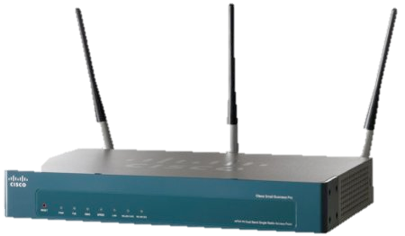
Application : Control heating based on occupancy

Slide 5

Application : WiFi Geo-Fencing

Slide 6
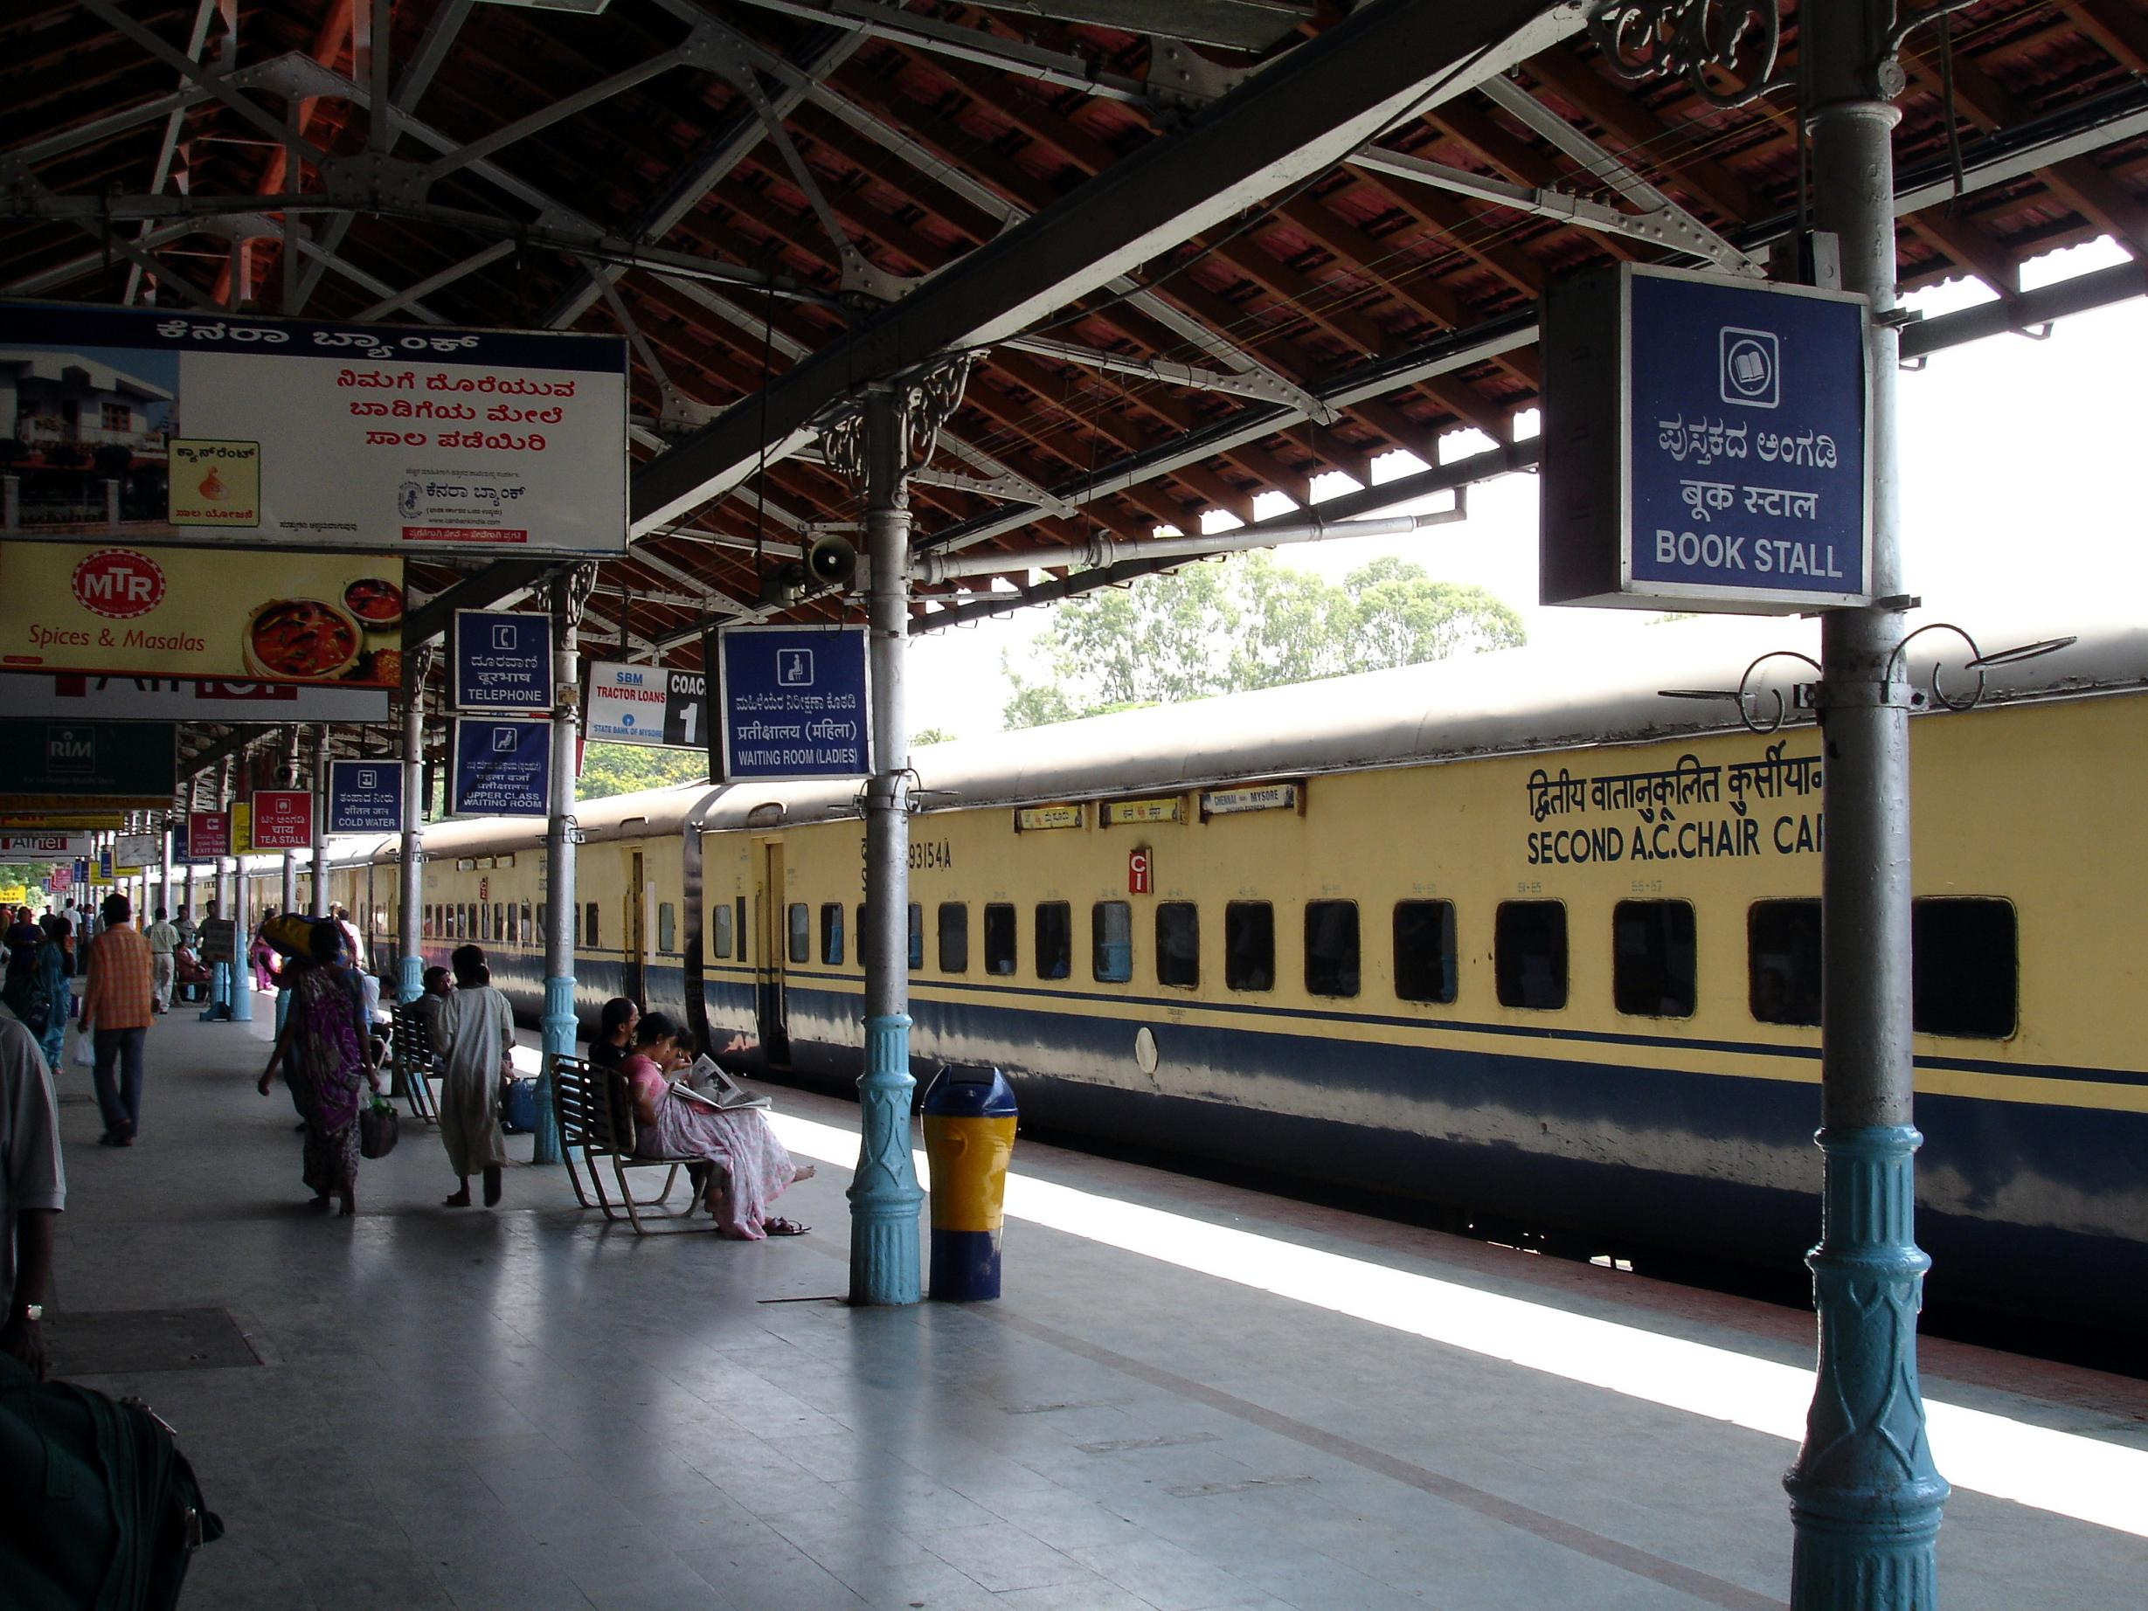
Application : Device-to-device Localization
Enable device-to-device localization without infrastructure support

Slide 7
Chronos
Enables decimeter-accurate localization using a single off-the-shelf WiFi card
A novel algorithm to estimate propagation time (Time of Flight, TOF) to sub-nanosecond accuracy using a WiFi card
Implemented and evaluated in practical settings

Slide 8
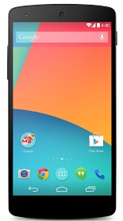

Why past work needs multiple AP’s? Related Work: ArrayTrack [NSDI’13], SpotFi [SIGCOMM’ 15]
$$θ$$

Slide 9
Single Access Point? Related Work:SAIL [MobiSys’ 14] ,CUPID[MobiSys’13]
distance
$$θ$$

Slide 10
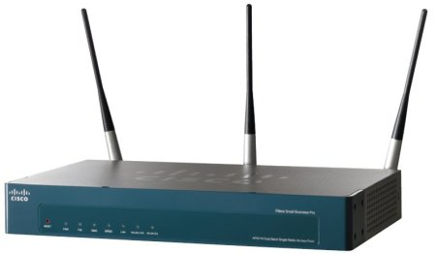
Measuring Distance
How do we measure propagation delay?
Distance = speed of light x propagation delay

Slide 11
Propagation Delay
τ
Ae^{j2πfτ}
Phase of the signal(ϕ) = 2πfτ mod 2π

Slide 12
Propagation Delay: Example
2.41 GHz
0
0.5
1
1.5
t (ns)
ϕ= 2πfτ mod 2π

Slide 13

Propagation Delay: Example
5.8 GHz
5.18 GHz
2.48 GHz
2.41 GHz
0
0.5
1
1.5
t (ns)

Slide 14
Mathematically
ϕ= 2πfτ mod 2π
τ= ϕ/(2πf) mod 1/f
τ= ϕ₁/(2πf₁) mod 1/f₁
τ= ϕ₂/(2πf₂) mod 1/f₂
……
Use Chinese Remainder Theorem to get the propagation delay
τ= ϕ_{n}/(2πf_{n}) mod 1/f_{n}

Slide 15
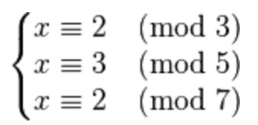

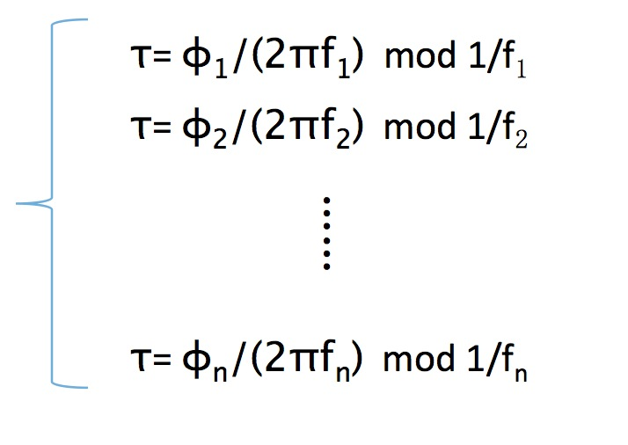

Slide 16
Can’t measure propagation delay without detection delay
Distance = speed of light x propagation delay
Measured delay = propagation delay + detection delay

Slide 17
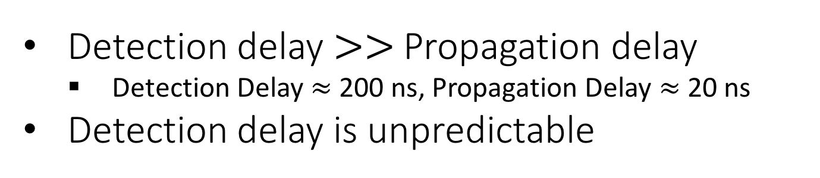
Packet Detection Delay
Detection Delay
Detection
Decoding
Detection delay $>>$ Propagation delay
Detection Delay $≈$ 200 ns, Propagation Delay $≈$ 20 ns
Detection delay is unpredictable
How do we eliminate detection delay?

Slide 18
Problem: Separate detection delay from propagation delay
Solution: Leverage that propagation delay and detection delay happen at different frequencies
f
f-f_{c}
Detection
Decoding
Propagation Delay
Detection Delay

Slide 19
f
f-f_{c}
Detection
Decoding
Propagation Delay (τ)
Detection Delay (τ’)
ϕ= 2πfτ mod 2π
ϕ= 2πfτ + 2π(f-f_{c})τ‘ mod 2π

Slide 20
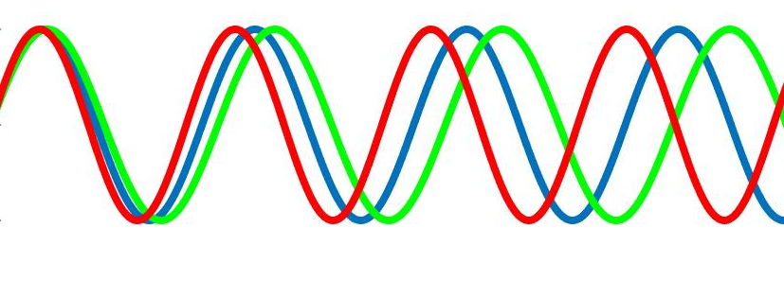
f
f-f_{c}
Detection
Decoding
Propagation Delay (τ)
Detection Delay (τ’)
ϕ= 2πfτ mod 2π
ϕ= 2πfτ + 2π(f-f_{c})τ‘ mod 2π
Idea: Use OFDM to measure phase at f=f_{c}

Slide 21
But WiFi does not transmit at f=f_{c}

Slide 22








Solution: Leverage OFDM
ϕ= 2πfτ + 2π(f-f_{c})τ‘ mod 2π
ϕ_{c}= 2πf_{c}τ + 0 mod 2π
Phase
Phase at f=f_{c}
$$φ_{c}$$
$$f_{c}−3δ$$
$$f_{c}−2δ$$
$$f_{c}−δ$$
$$f_{c}$$
$$f_{c}+δ$$
$$f_{c}+2δ$$
$$f_{c}+3δ$$

Slide 23
Mathematically
ϕ_{c}= 2πf_{c} τ mod 2π
τ= ϕ_{c}/(2πf_{c}) mod 1/f_{c}
τ= ϕ_{1c}/(2πf_{1c}) mod 1/f_{1c}
τ= ϕ_{2c}/(2πf_{2c}) mod 1/f_{2c}
Chronos eliminates packet detection delay by leveraging OFDM properties
……
τ= ϕ_{nc}/(2πf_{nc}) mod 1/f_{nc}

Slide 24
Additional System Components
Initial Phase Offset Compensation and Carrier Frequency Offset
Multipath resolution

Slide 25
Additional System Components
Initial Phase Offset Compensation and Carrier Frequency Offset
Multipath resolution

Slide 26
Initial Phase Offsets and Carrier Frequency Offset
τ
ϕ= 2πfτ + Δϕ + (Δf)t mod 2π

Slide 27
Idea: Use Acknowledgements
τ
ϕ₁= 2πfτ + Δϕ + (Δf)t mod 2π
ϕ₂= 2πfτ – Δϕ - (Δf)t mod 2π
Chronos eliminates phase offsets by using acknowledgements
ϕ₁+ϕ₂= 4πfτ mod 2π

Slide 28
Additional System Components
Initial Phase Offset Compensation and Carrier Frequency Offset
Multipath resolution

Slide 29
Problem: Multipath Effect

Slide 30
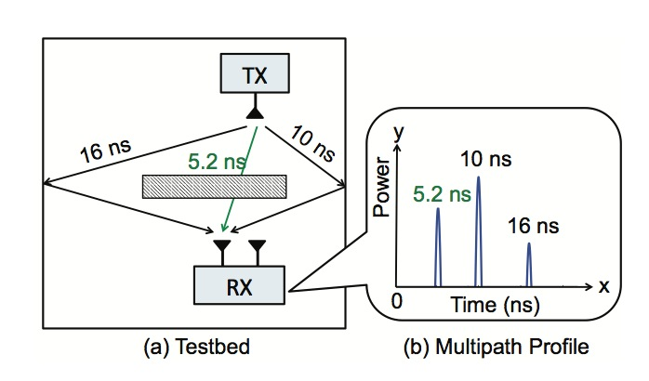
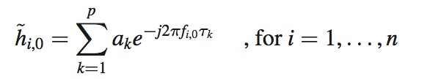
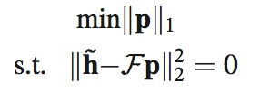


Slide 31
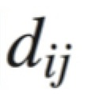
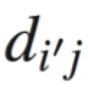
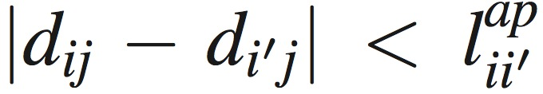
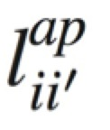
Localization
j
i
i’

Slide 32
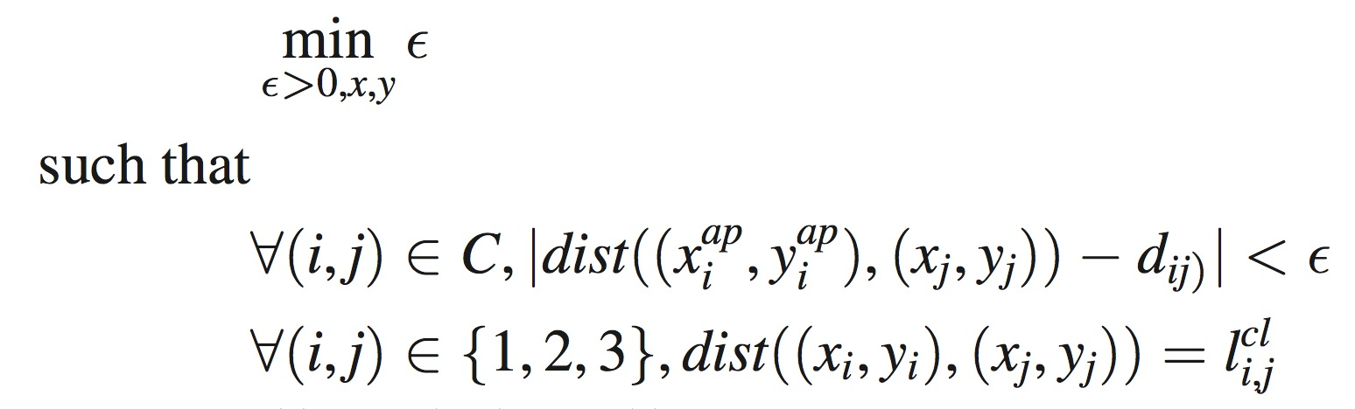
Localization

Slide 33
Experimental Evaluation

Slide 34
Implementation
Evaluation with off-the-shelf Intel WiFi 5300 cards
Kernel modifications to the iwlwifi driver in the Ubuntu kernel
Ground truth measurements using laser distance measurement device ( 1mm accurate)

Slide 35
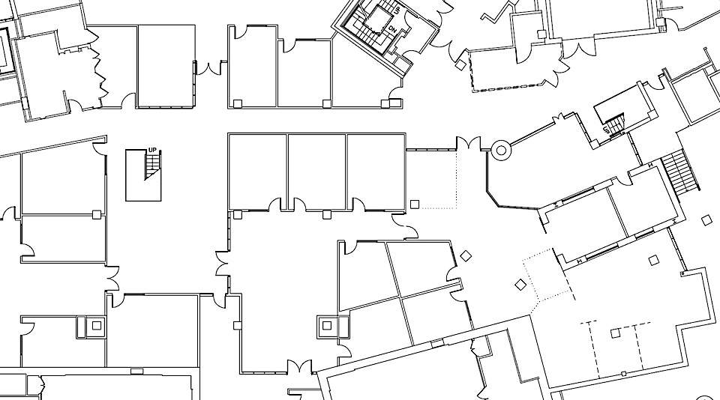
Evaluation Testbed: Office Environment
20 m
20 m

Slide 36
Distance Measurement Accuracy
21 cm
14 cm

Slide 37
Localization Accuracy
SpotFi (SIGCOMM’ 15)
3 AP’s | 190 cm
4 AP’s | 80 cm
5 AP’s | 60 cm
98 cm
65 cm
Chronos can achieve state-of-the-art localization accuracy with a single AP

Slide 38
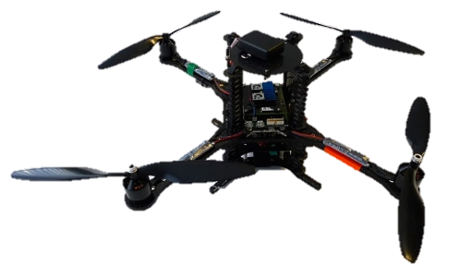
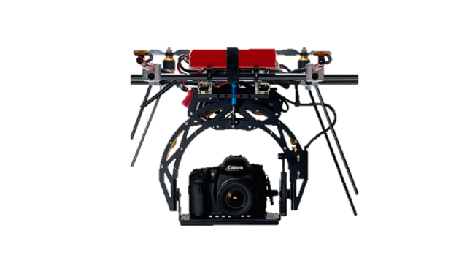




Applications
Smart Homes
Device to Device localization
WiFi Geo-fencing

Slide 39
Applications
Smart Homes
Device to Device localization
WiFi Geo-fencing

Slide 40
Application: Smart Homes
Bedroom1
Bedroom2
Living room
9 m
Chronos detects the correct room with accuracy 94%.
Kitchen
Bath
13 m

Slide 41
Applications
Smart Homes
Device to Device localization
WiFi Geo-fencing

Slide 42
Application: GeoFencing
Coffee Station
7 m
Chronos can accurately authenticate WiFi users with 97% accuracy.
9 m

Slide 43
Applications
Smart Homes
Device to Device localization
WiFi Geo-fencing

Slide 44

Application: TakeMyPicture Drone
d

Slide 45
Application: TakeMyPicture Drone
y (m)
User
Drone
1.4 m
x (m)

Slide 46
Application: TakeMyPicture Drone
4.2 cm
Chronos enables a drone to follow the user with no infrastructure support.

Slide 47
Related Work
WiFi Localization: SpotFi [SIGCOMM’ 15], ToneTrack [Mobicom’ 15], Phaser [Mobicom’ 14], Tagoram [Mobicom’ 14], ….
Closest Work: SAIL [MobiSys’ 14]

Slide 48
Conclusion
Enables decimeter-accurate localization using a single off-the-shelf WiFi card
Its key enabler is a novel algorithm that can estimate accurate propagation delay, by eliminating the detection delay

