Slide 1
From QoS to QoE: A Tutorial on Video Quality Assessment
Yanjiao Chen, Kaishun Wu, and Qian Zhang

Slide 2
Background
Video Quality Assessment
Video transmission optimization
Congestion control
Video streaming
Media player buffer design

Slide 3
Background
QoS (Quality of Service)
Provider side metrics, objective
QoE (Quality of Experience)
Viewer side metrics, subjective
QoS + External Factors → QoE

Slide 4
Background

Slide 5
Background
Quality Assessment Evolution

Slide 6
Background

Slide 7
Subjective Test
Test Preparation
Test Execution
Data Processing
Results Presentation

Slide 8
Subjective Test
High cost
Limited assessors
Controlled environment
Limited distortion types
Distortion factor correlation
Hard to account for frame of different importance
Not for online QoE estimation

Slide 9
Objective Quality Model
Psychophysical/Engineering
Full Reference/Reduced Reference/No Reference
Notes:
The psychophysical approach is mainly based on characterizing the mechanisms of the HVS, such as masking effect, contrast sensitivity, and adaptation to color and illumination. The engineering approach is based on extracting and analyzing certain distortion patterns or features of the video, such as statistical features, structural similarity (SSIM) and compression artifacts (e.g., blockiness, edginess).

Slide 10
Objective Quality Model (FR)
Compare distorted video with original video to calculate QoE.
Pixel-based Models
Psychophysical Approach
Engineering Approach

Slide 11
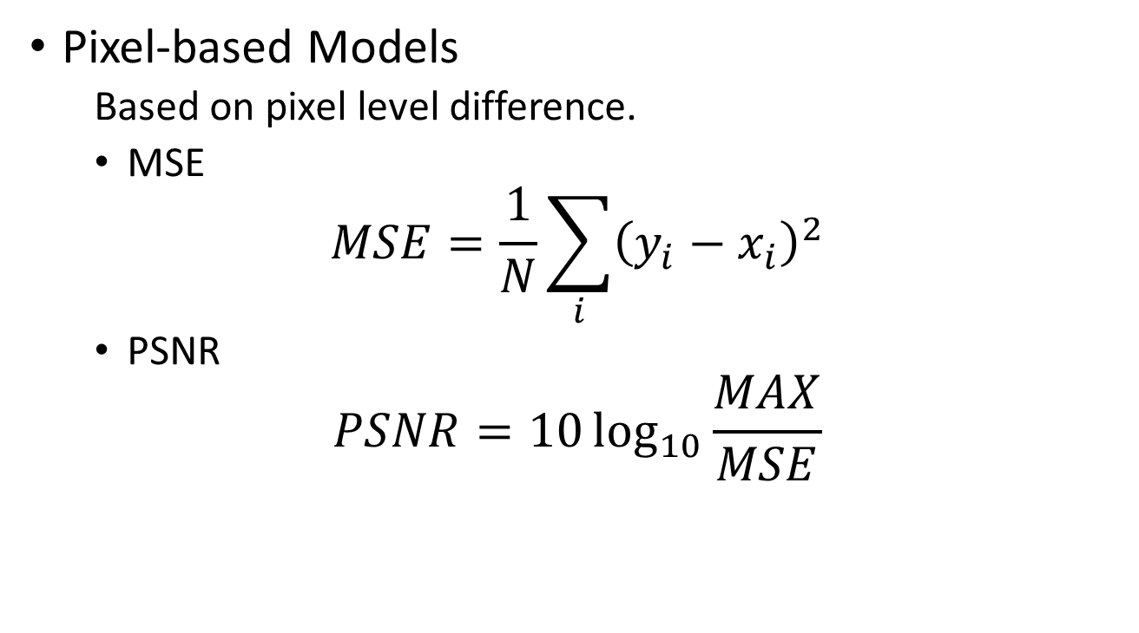
Objective Quality Model (FR)
Pixel-based Models
Based on pixel level difference.
MSE
$$MSE=\frac{1}{N}\sum_{i}{{\left(y_{i}−x_{i}\right)}^{2}}$$
PSNR
$$PSNR=10\log_{10}{\frac{MAX}{MSE}}$$

Slide 12
Objective Quality Model (FR)
Psychophysical Approach
Based on human vision: contrast sensitivity, frequency selectivity, masking effects, color perception.
VSNR (Visual SNR)
Compute distortions
DWT
Threshold Filter
Global Precedence

Slide 13
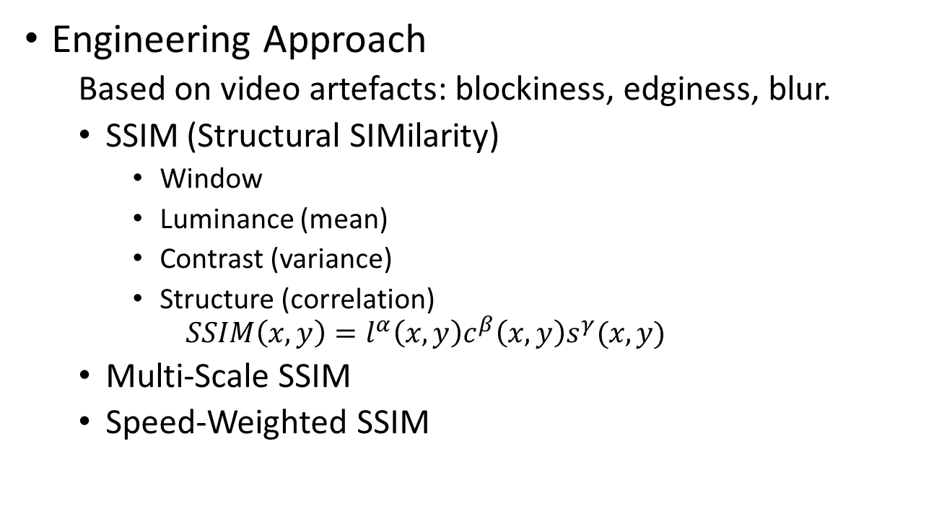
Objective Quality Model (FR)
Engineering Approach
Based on video artefacts: blockiness, edginess, blur.
SSIM (Structural SIMilarity)
Window
Luminance (mean)
Contrast (variance)
Structure (correlation)
$$SSIM\left(x,y\right)=l^{α}\left(x,y\right)c^{β}\left(x,y\right)s^{γ}(x,y)$$
Multi-Scale SSIM
Speed-Weighted SSIM

Slide 14
Objective Quality Model (RR)
Some information can be extracted from the distorted videos.
Packet Loss Visibility Based Model
Temporal duration
Slice or frame loss
Vertical position

Slide 15
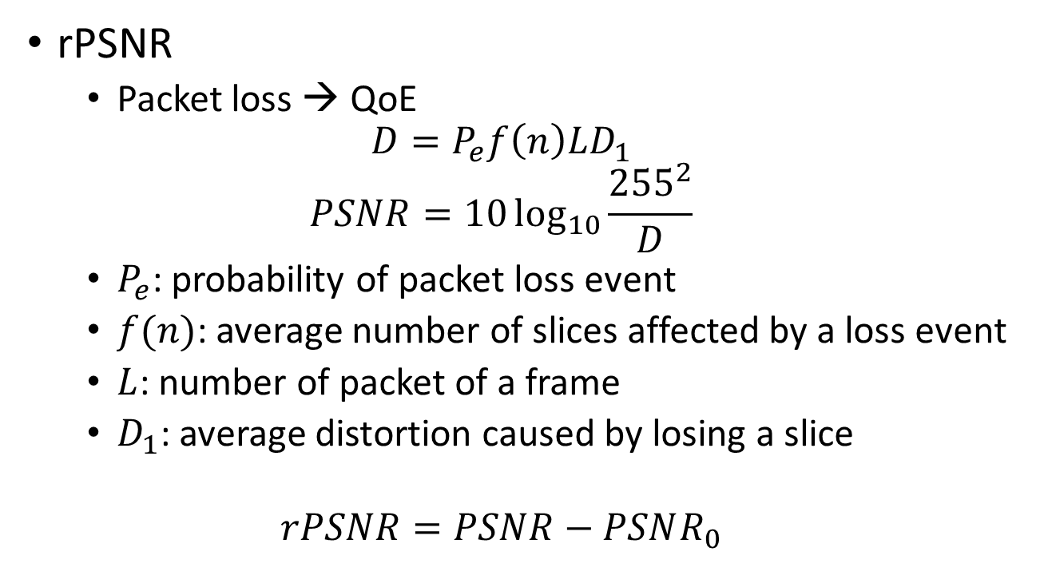
Objective Quality Model (NR)
rPSNR
Packet loss → QoE
$$D=P_{e}f\left(n\right)LD_{1}$$
$$PSNR=10\log_{10}{\frac{{255}^{2}}{D}}$$
$P_{e}$: probability of packet loss event
$f(n)$: average number of slices affected by a loss event
$L$: number of packet of a frame
$D_{1}$: average distortion caused by losing a slice
$$rPSNR=PSNR−PSNR_{0}$$

Slide 16
Objective Quality Model

Slide 17
Objective Quality Model
Insufficient knowledge of human vision
Compound and suprathreshold distortions
Interaction of the distortion and the image
Interaction between distortions
Geometric changes
Evaluation of enhanced image
Efficiency

Slide 18
Data-Driven QoE Analysis
QoS + External Factors ---[Relation]---> QoE
↑
Data
QoS Metrics
Bitrate, rate of buffering, startup delay
External Factors
Video length, popularity, content type
QoE Metrics
Viewing time, abandonment rate

Slide 19
Data-Driven QoE Analysis
Correlation and Linear Regression Based Analysis
Flow
Correlation (monotonic)
Information Gain
Linear Regression
Problems
Non-monotonic relationship
Interdependence between QoS parameters
External factors

Slide 20
Data-Driven QoE Analysis
Decision Tree Based QoE Prediction Model
Flow
Data Pruning
QoS Decision Tree Building
External Factors Identification
Problems
Discrete parameter
Discrete result

Slide 21
Compare All Approaches

Slide 22
Compare All Approaches
 | Direct Masure QoE | Objective or Subjective | Real-time | Wide application | Cost
QoS Monitoring | No | Obj | Yes | Wide | Not Sure
Subjective Test | Yes | Subj | No | Limited | High
Objective Quality Model | No | Obj | Yes/No | Limited | Low
Data-Driven Analysis | Yes | Obj | Yes | Wide | Not Sure

Slide 23
Applications
Cross-Layer Video Transmission Optimization
Priority Mapping Mechanism
QoE-Aware Congestion Control
Video Transmission Over Wireless Network
QoE-Aware Video Streaming
DASH
Media Player Buffer Design
More buffering/Longer startup delay

Slide 24
Future Direction
Development of Data-Driven QoE Research
QoE-Based Video Transmission Optimization
QoE Evaluation in Emerging Technologies
3D Video
Interactive Video
Ultra Definition Video
New Transmission Network (Mobile, Sensor, Vehicular)
QoE-Based Internet Video Economics

Slide 25
Conclusion
Monitoring QoE is important
Subjective test is a direct way but costly
Objective models and data-driven models indirectly predict QoE
No reference models and data-driven models can be used in real-time video transmission

