Slide 1
Acoustic Eavesdropping through Wireless Vibrometry
Teng Wei, Shu Wang, Anfu Zhou and Xinyu Zhang
University of Wisconsin – Madison Chinese Academy of Sciences
Institute of Computing Technology
Chinese Academy of Sciences

Slide 2

Acoustic Eavesdropping through Wireless
Loudspeaker and Wi-Fi are widely used in the conference and home environment
Image wireless can pick up the sound and leak private information

Slide 3



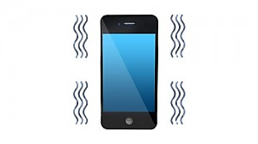



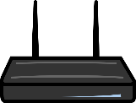

Threat Models
Reflective
Emissive
Victim
AP
Victim
Wall
Wall
Tx
Rx
Rx
Attacker
Attacker

Slide 4
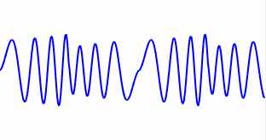


How Possible?
Acoustic-Radio Transformation (ART)
Translate acoustic vibration into radio signal fluctuation

Slide 5
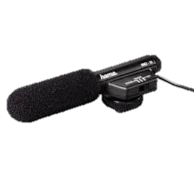
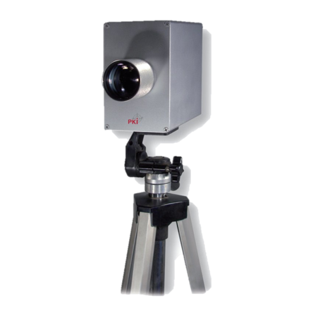
Pros and Cons: Technique Review
Directional Microphones
Widely used in espionage and newsgathering
Fail in the sound-proof environment
Laser-based Microphone
Highly directional and sensitive
Require unobstructed line-of-sight between the subject and laser
Microwave-based Microphone
Penetrate sound-proof material and unblocked by obstacles

Slide 6
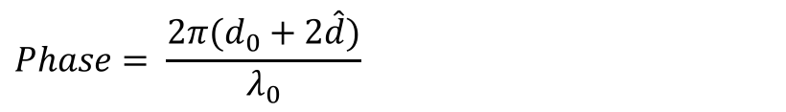
Understand Basic ART
Physical Model
DC component
High-order harmonics
RSS-based ART
$$RSS= σA^{2}\left(d_{0}+\hat{d}\right)=σ[A^{2}\left(d_{0}\right)+2A\left(d_{0}\right)A^{′}\left(d_{0}\right)\hat{d}+…]$$
Audio signal component
Radio pathloss
Taylor expansion
DC component
Phase-based ART
Audio signal component
$$Phase= \frac{2π(d_{0}+2\hat{d})}{λ_{0}}$$
Micro Doppler
Audio Decoding of ART
Radio sampling frequency >> Audio sampling frequency
Modulate a known sequence
Frequency domain analysis
Estimate Channel
RSS/Phase
Assemble audio signals
Passband filter

Slide 7
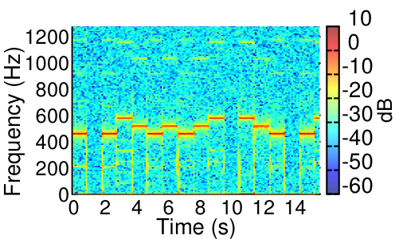

Validating Feasibility
Setup
Result
Piano sound 440Hz, 493.88Hz, 554.37Hz
2m
High-order harmonics
Tx
0.5m
Rx
CW 5MHz
Channel 14 2.485GHz
Diversity

Slide 8
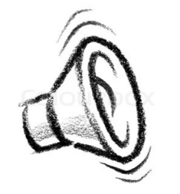
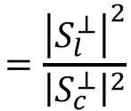
Influence of Multipath
Wireless signal is broadcasting in natural
Background
Reflection Path
Loudspeaker
Reflection Path
Tx
Rx
Multipath affects eavesdropping quality
Received signal
Loudspeaker reflection
Background reflection
S
Q
S
Q
S_{c}
S_{c}
S_{l}
S_{l}
I
I
Good multipath profile
$$=\frac{{\left|S_{l}^{⊥}\right|}^{2}}{{\left|S_{c}^{⊥}\right|}^{2}}$$
>
Quality
Quality’

Slide 9
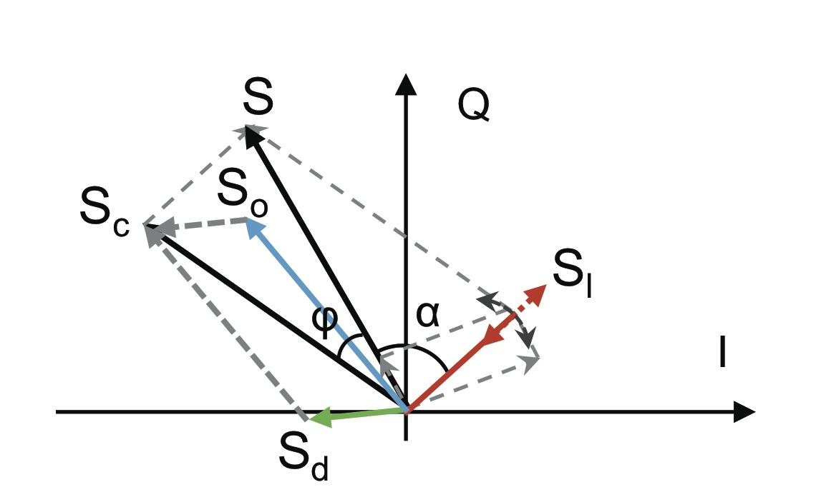

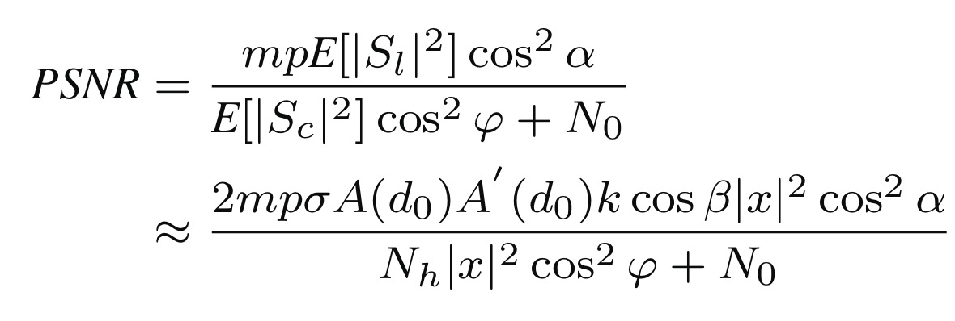

Slide 10


Enhanced 1: Spatial Diversity
Basic Idea
Antenna 1
Antenna 2
Beamform
S
Q
Q
Improved eavesdropping quality
Q
S_{c}
$$×w_{1}+$$
$$×w_{2}=$$
S_{l}
S_{l}
S_{l}
I
S
I
S
I
S_{c}
S_{c}
Weight Searching
Problem: no channel training
Solution: blind beamforming algorithm
Role-switching Beamform
Problem: how to find Tx beamforming weights?
Rx weight search 1
Role-switch
Rx weight search 2
Rx
Tx
Tx
Rx
Rx
Tx
Radio 1
Radio 2
Radio 1
Radio 2
Radio 1
Radio 2

Slide 11
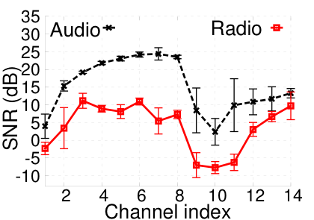
Enhanced 2: Frequency Diversity
Basic Idea
Alter angles of multipath profile
Channel 1
Channel 7
S
Q
S
Q
S_{c}
S_{l}
S_{l}
S_{c}
I
I
Avoid interference
Validation
Diversity gain
Interference

Slide 12
Enhanced Emissive ART
AP
Attacker Rx
Audio Recovery (WiFi decoding)
STF
LTF
Header
Payload
①
②
③
Packet detection
CSI estimation
Audio assembling
Problem 1: Non-uniform packet arrival
Problem 2: Inaccurate signal amplitude estimation
LTF
Payload
time
2 OFDM symbols
100+ OFDM symbols
Solution: audio sample re-interpolation
Solution: RSS estimation and amplification

Slide 13

Counter Measure: Reflective ART
Safety Distance
Free space model
2.4 GHz
12dB antenna gain
Drywall
Typical WiFi Hardware
Interfering Mechanical Vibrations
Human movement
Rotating fan
…

Slide 14
Counter Measure: Emissive ART
Transmission Power Randomization
Original power of packets
Power
Uplink WiFi packets
time
Randomized power of packets
Power
time

Slide 15
Implementation and Testbed
Reflective ART decoder
802.11g/n-compliant communication library
WARP FPGA modification
WARP and WURC SDR testbed
Software Implementation
Testing Loudspeakers
Altec Lansing Multimedia Computer Speakers

Slide 16
Experiment Setup
Conference Room
Diversity gain
Distance to antenna: 1 ~ 5m
Sound-proof Room

Slide 17
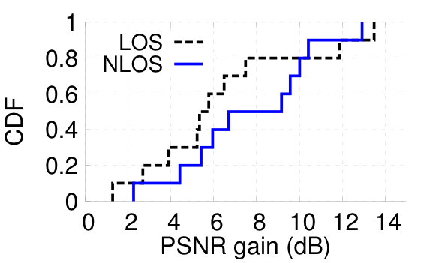
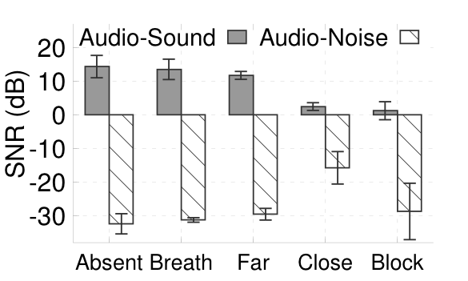
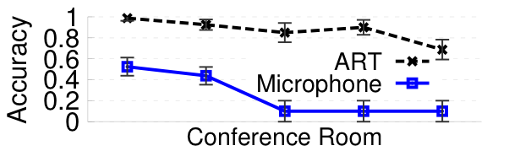
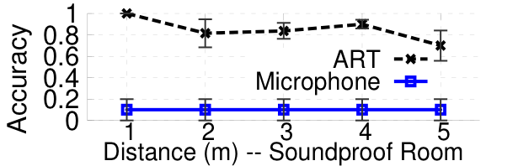

Reflective Eavesdropping
Beamforming
Human Impact
Environment
Penetrate wall and conventional sound isolator

Slide 18
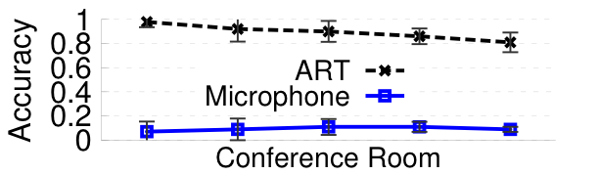
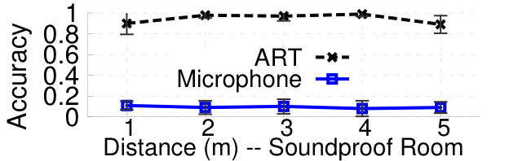

Emissive Eavesdropping
Experiment Setup
Victim: Moto X XT1053
AP: Belkin N150
Protocol: IEEE 802.11g
Running application: Iperf, TCP transferring at 10Mbps
Human Perception Accuracy
Good eavesdropping despite low sound volume

Slide 19
Effectiveness of Counter Measures
Validating Transmission Power Randomization (TPR)
Trace-driven simulation
Collect WiFi packet trace (1900pkt/s)
Enforce TPR on each of the collected packet
21dB
more than 2 orders of magnitude reduction

Slide 20
Conclusion
First to thoroughly investigate vibrometry on wireless devices and practical attack models
Distill key factors that enable highly sensitive WiFi vibrometry
Basic ART
Enhanced reflective ART
Enhanced emissive ART
Extensive experiments using COTS smartphone, WiFi access point, and software-radio eavesdropper
Pose alarming challenges to securing acoustic in formation

Slide 21
Questions?
Thank you

